Slide 1




Summer 2025 Internship (June 16th - August 8th)
Sandia National Laboratories
Nonlinear Mechanics and Dynamics Research Institute
Alan Pham
9-23-25

Slide 2

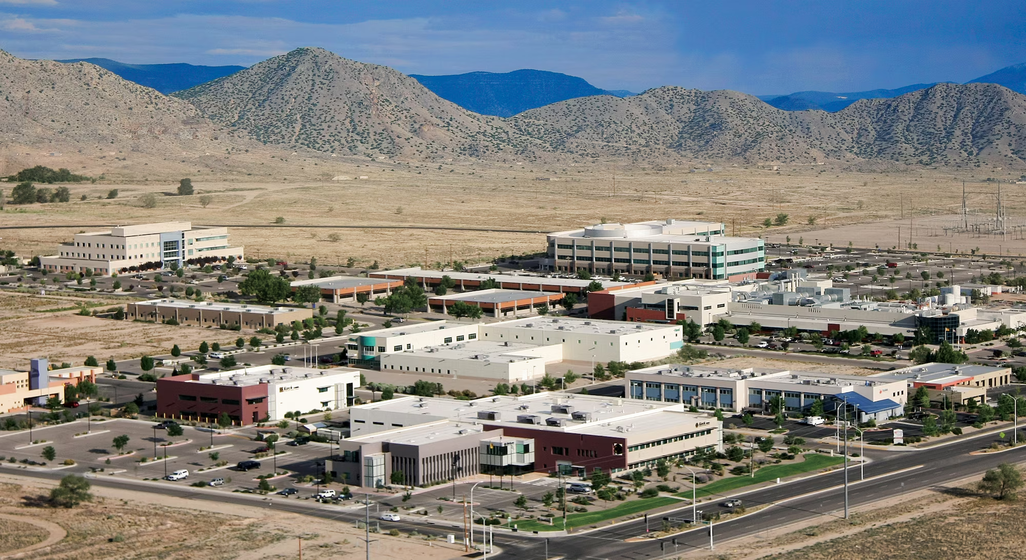
Sandia National Laboratories
Sandia Motto: “To render exceptional service in the national interest”
Everyone is called a “Sandian”
Established in 1949 to ensure the safety, reliability, and engineering of the U.S. nuclear weapons arsenal during the Cold War
1 of 3 labs of US National Nuclear Security Administration
  Lawrence Livermore National Labs
  Los Alamos National Labs
  Sandia National Labs
Headquartered in Kirtland Air Force Base in Albuquerque, New Mexico
Ownership and management
  Owned by US Federal government
  Privately managed and operated by National Technology and Engineering Solutions of Sandia
    which is owned by Honeywell International

Slide 3
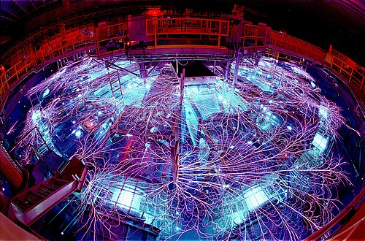
Research Areas
  Nuclear deterrence
  Arms control
  Nonproliferation
  Hazardous waste disposal
  Climate change
  Computational biology
  Physics
  Materials science
  Alternative energy
  Psychology
  MEMS
  Cognitive science
Largest electromagnetic wave generator in the world

Slide 4
Internship Overview
Nonlinear Dynamics and Mechanics Research Institute (NOMAD)
  Relevance to SRL: Soft robotics and compliant mechanisms can exhibit nonlinear behaviors that can be simulated and modeled
  Research lab within Sandia National Labs (SNL) specializing in component development
  Located in the mechanical engineering department of University of New Mexico (UNM)
Timeline (8 weeks from June 16th to August 8th)
  December 2024: interview offered
  March 2025: housing secured
  Before the institute: assigned readings, optional homeworks
  1st week: orientation, onboarding, training
  2-7th week: research work
  8th week: finalizing research presentation
  After internship: submit journal paper? conference paper? extended abstract?
Travel and shipments can be reimbursed

Slide 5
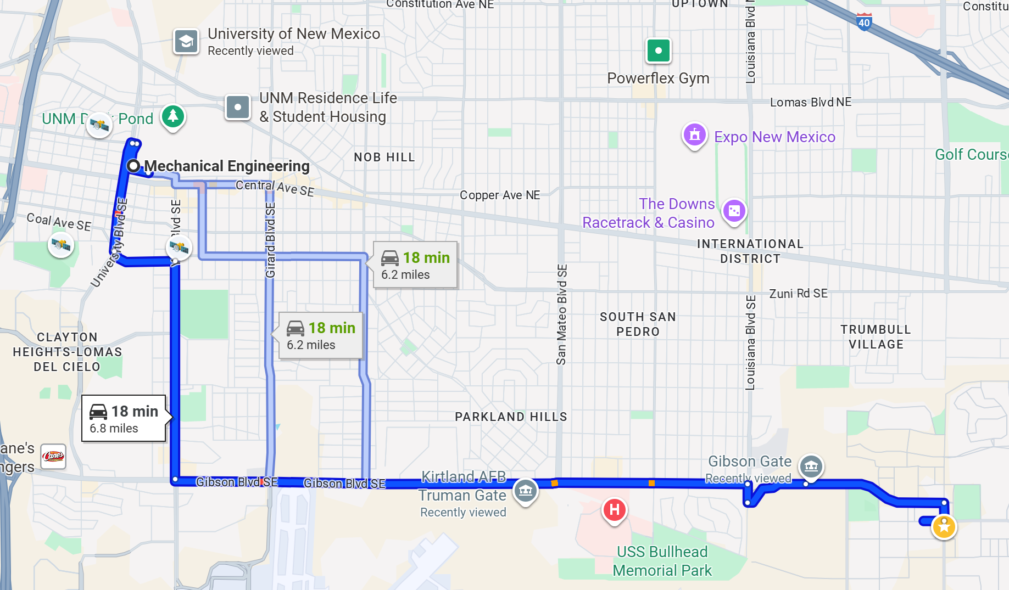
Kirtland Airforce Base to NOMAD

Slide 6
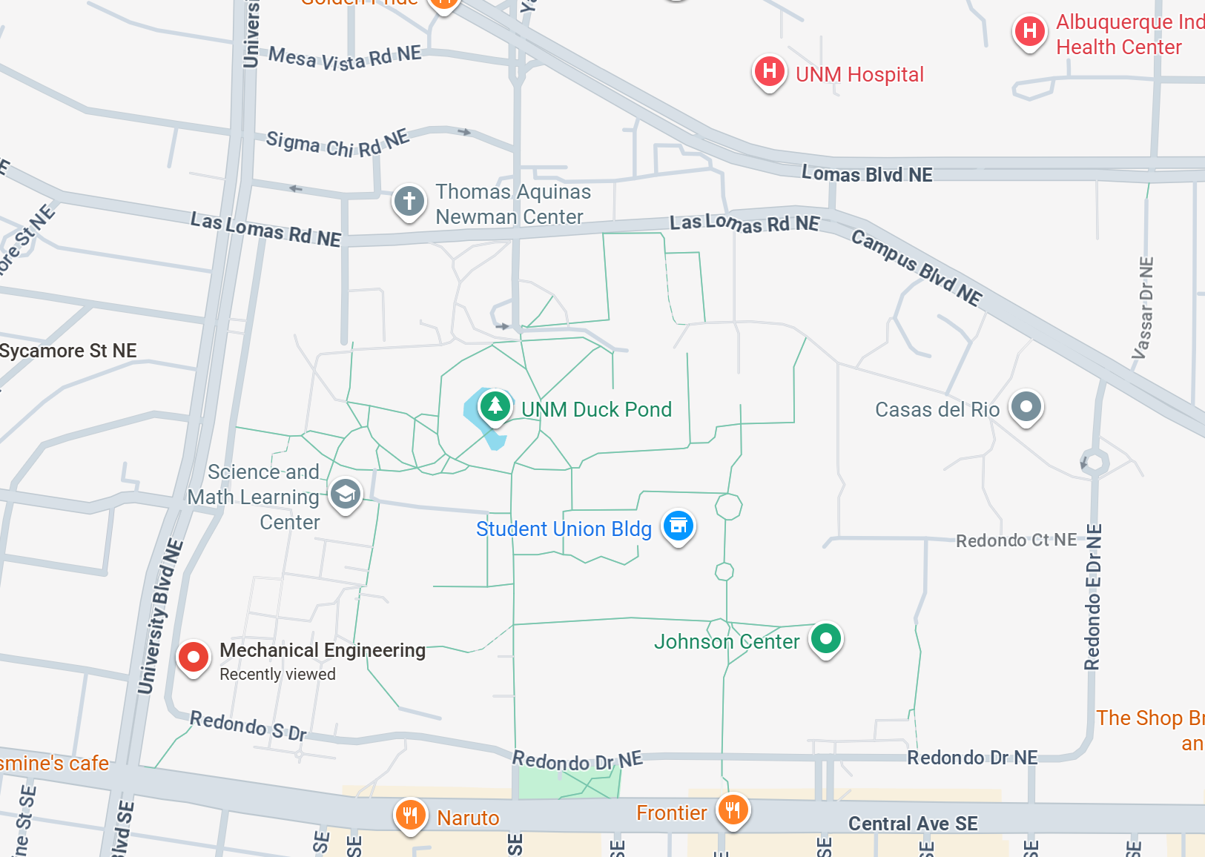
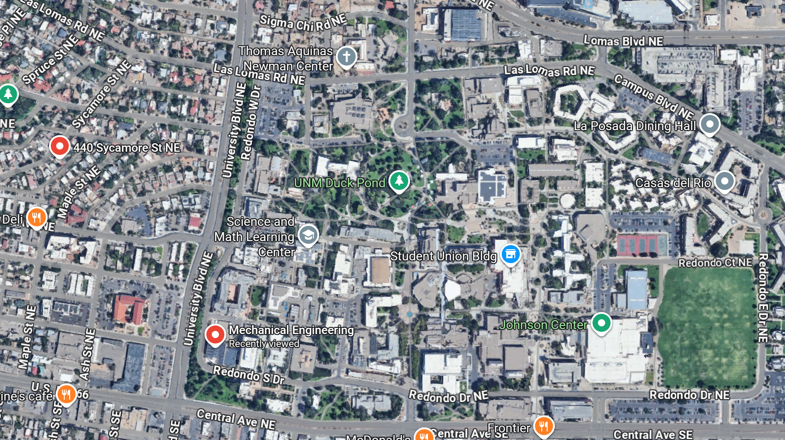


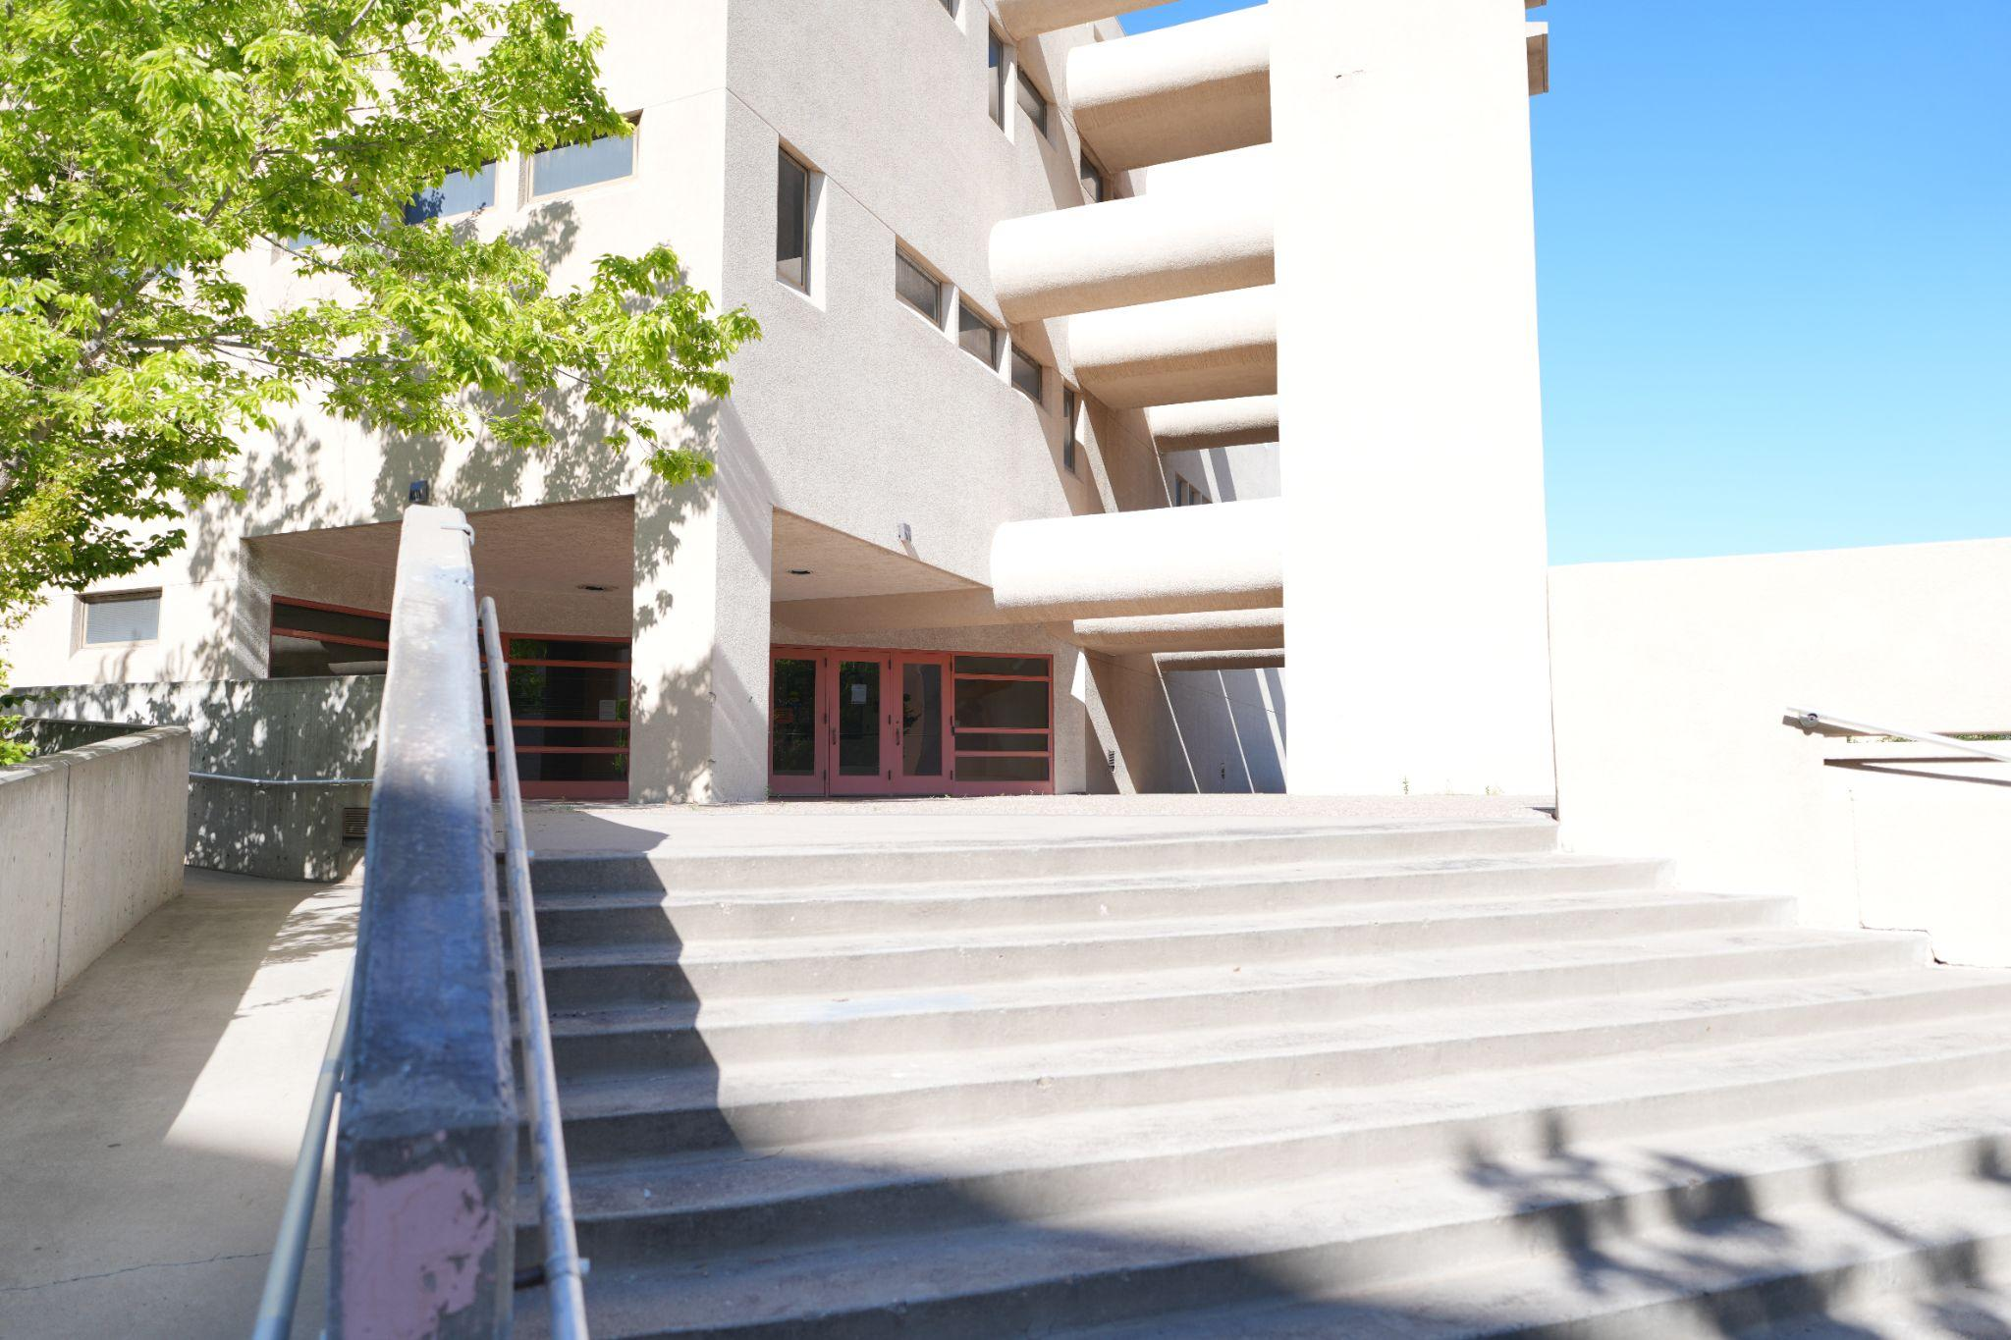
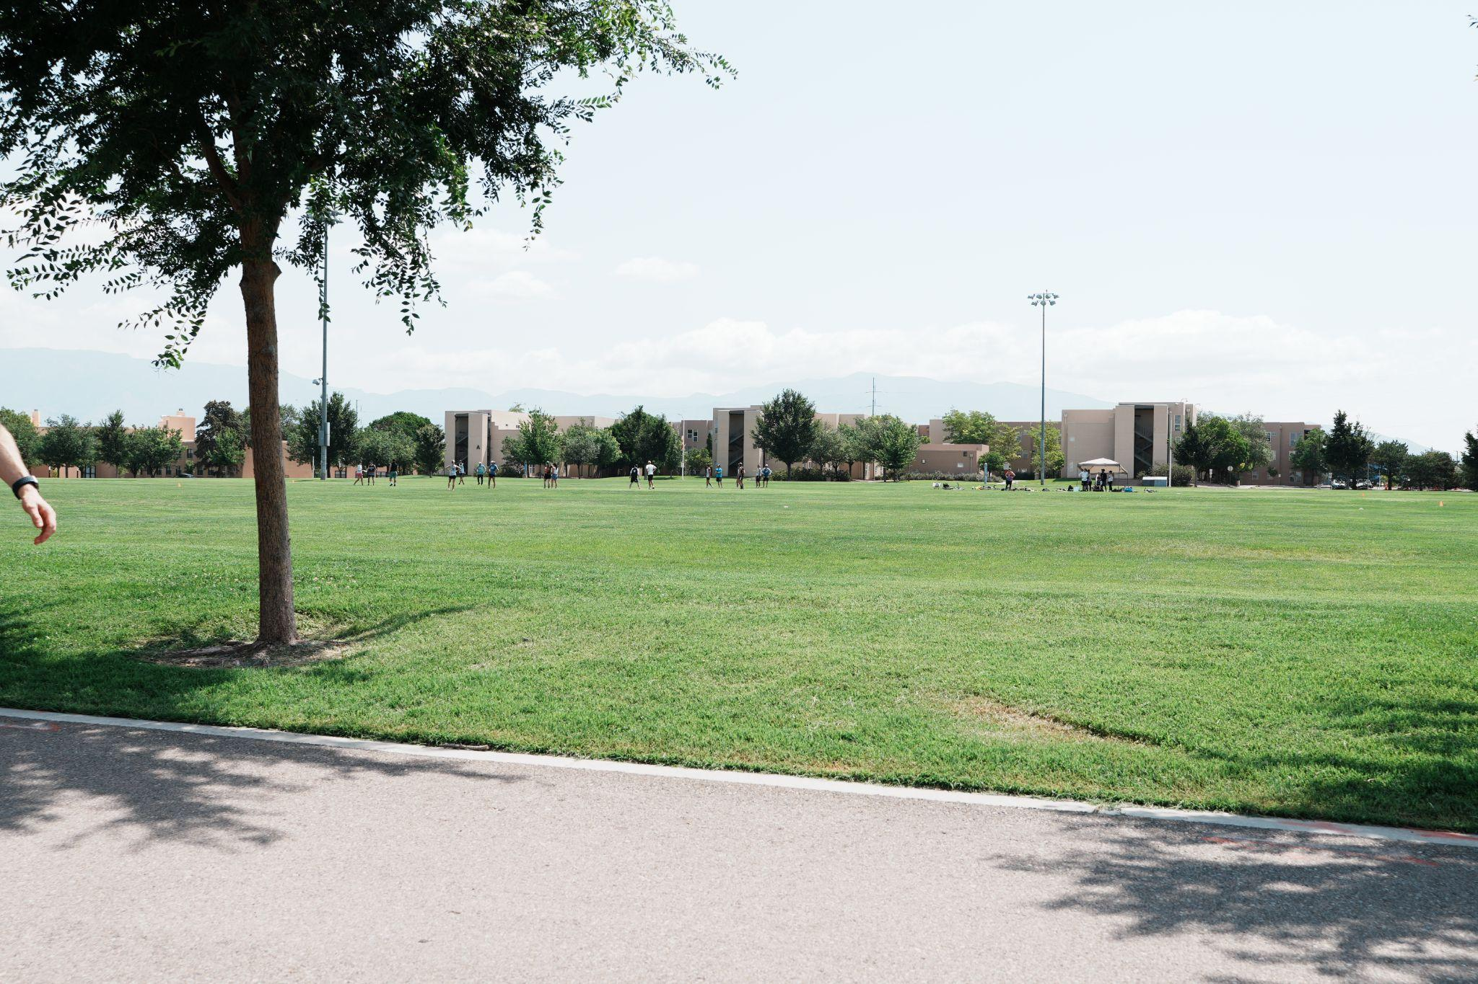
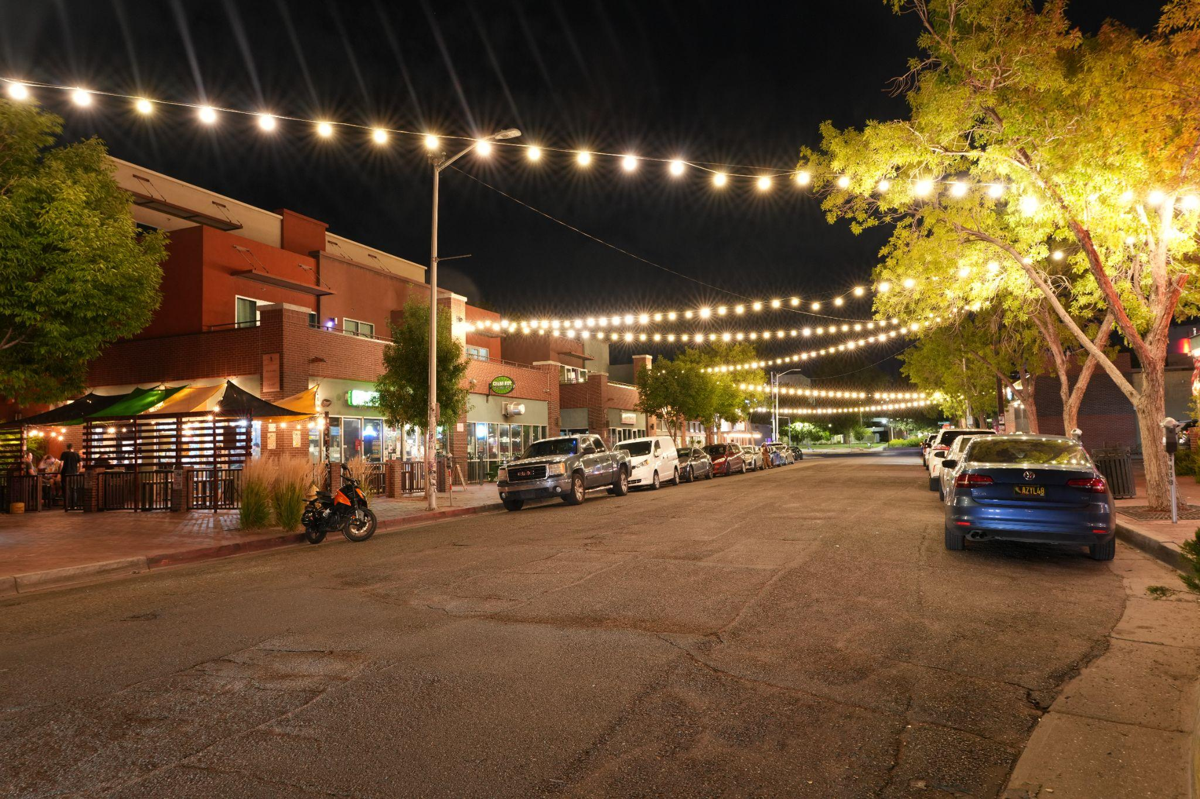
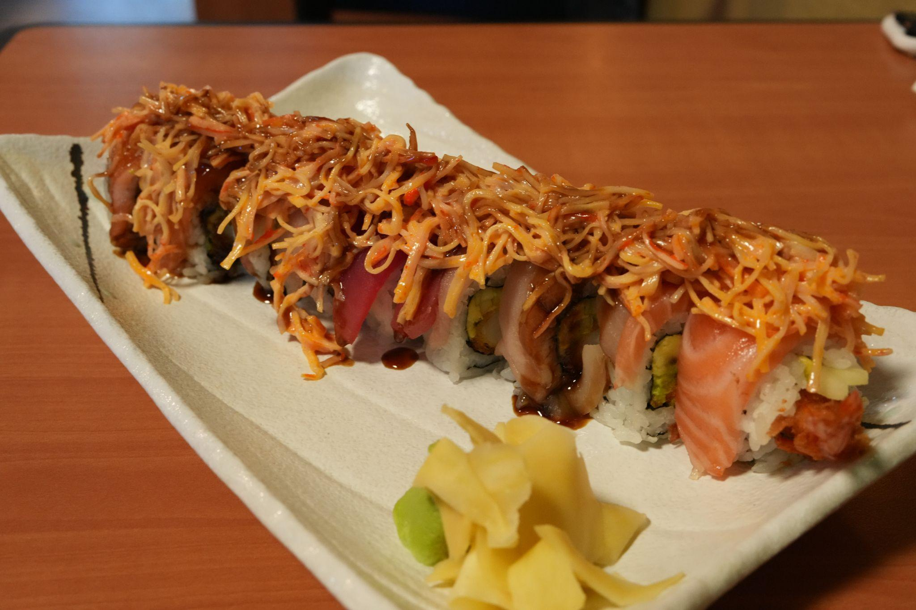
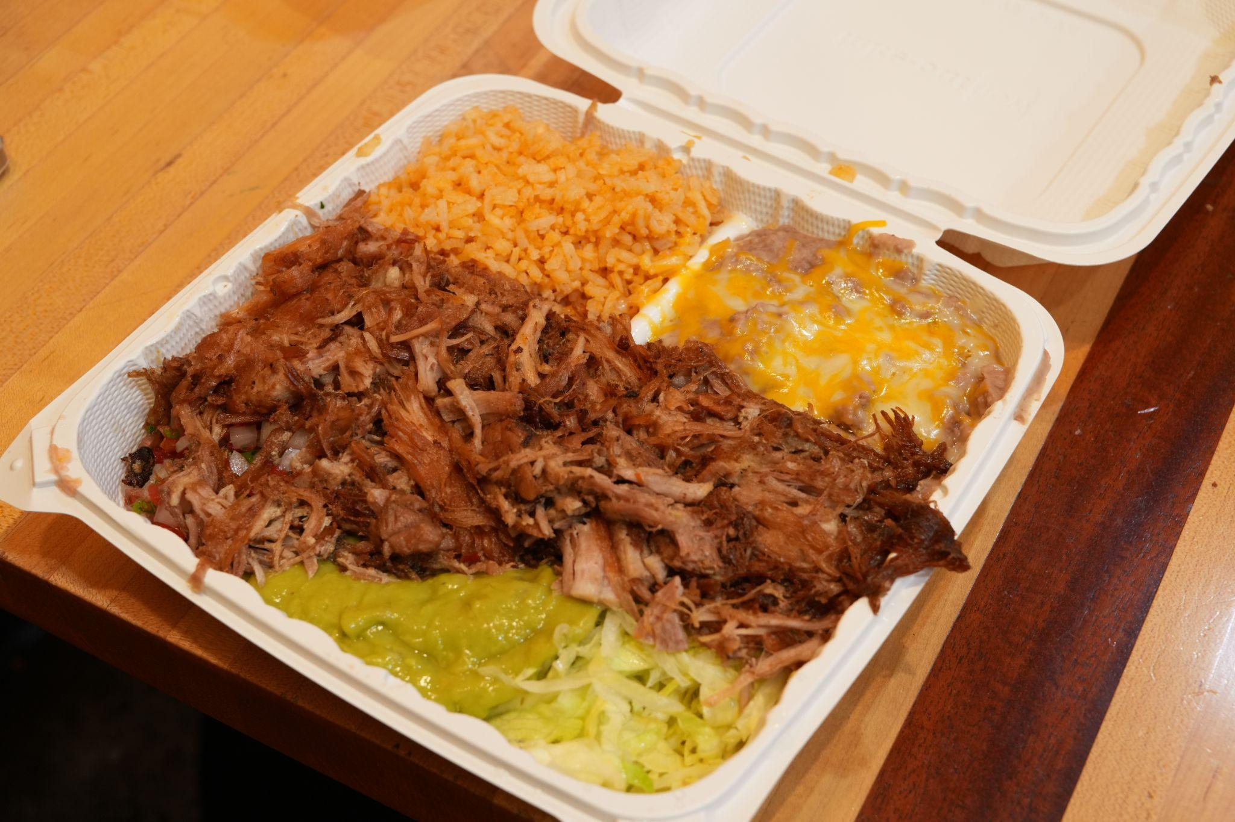
NOMAD at UNM

Slide 7
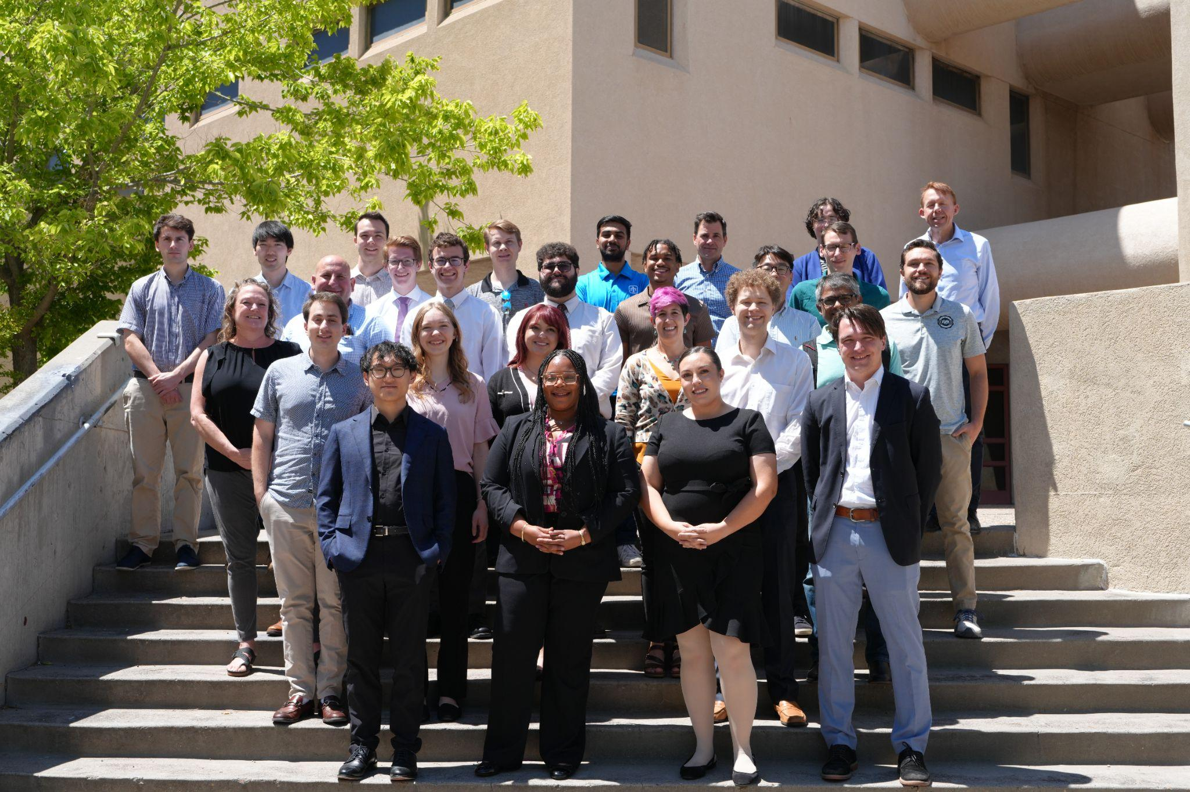
People
15-20 members
  Undergrad -> PhD
  Mechanical
  Aerospace
  Material science
  Biology?
Project teams
  3-5 mentor teams
  ~3 students
  Weekly mentor meeting
  Weekly standup
  Off-hours Discord
  40 hours/week in person

Slide 8
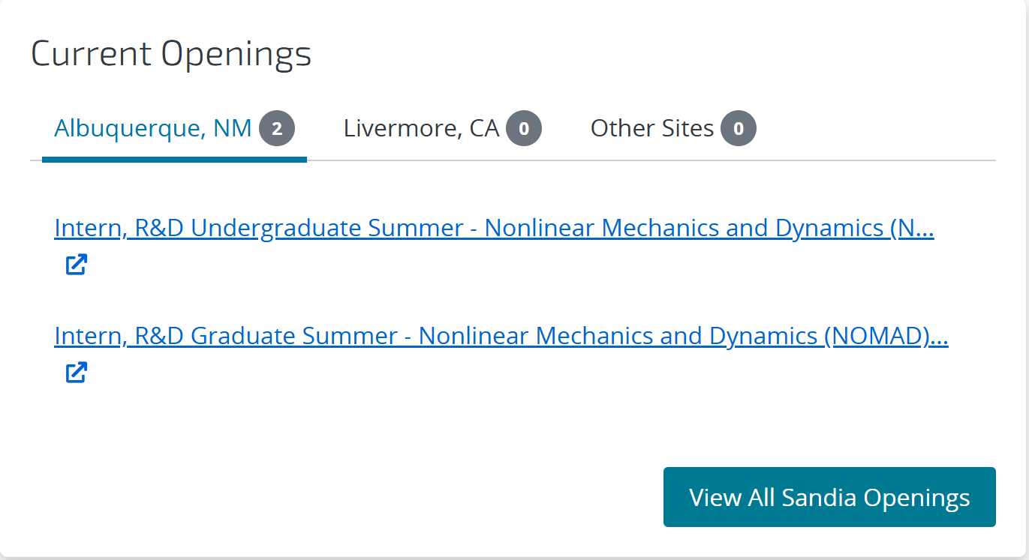
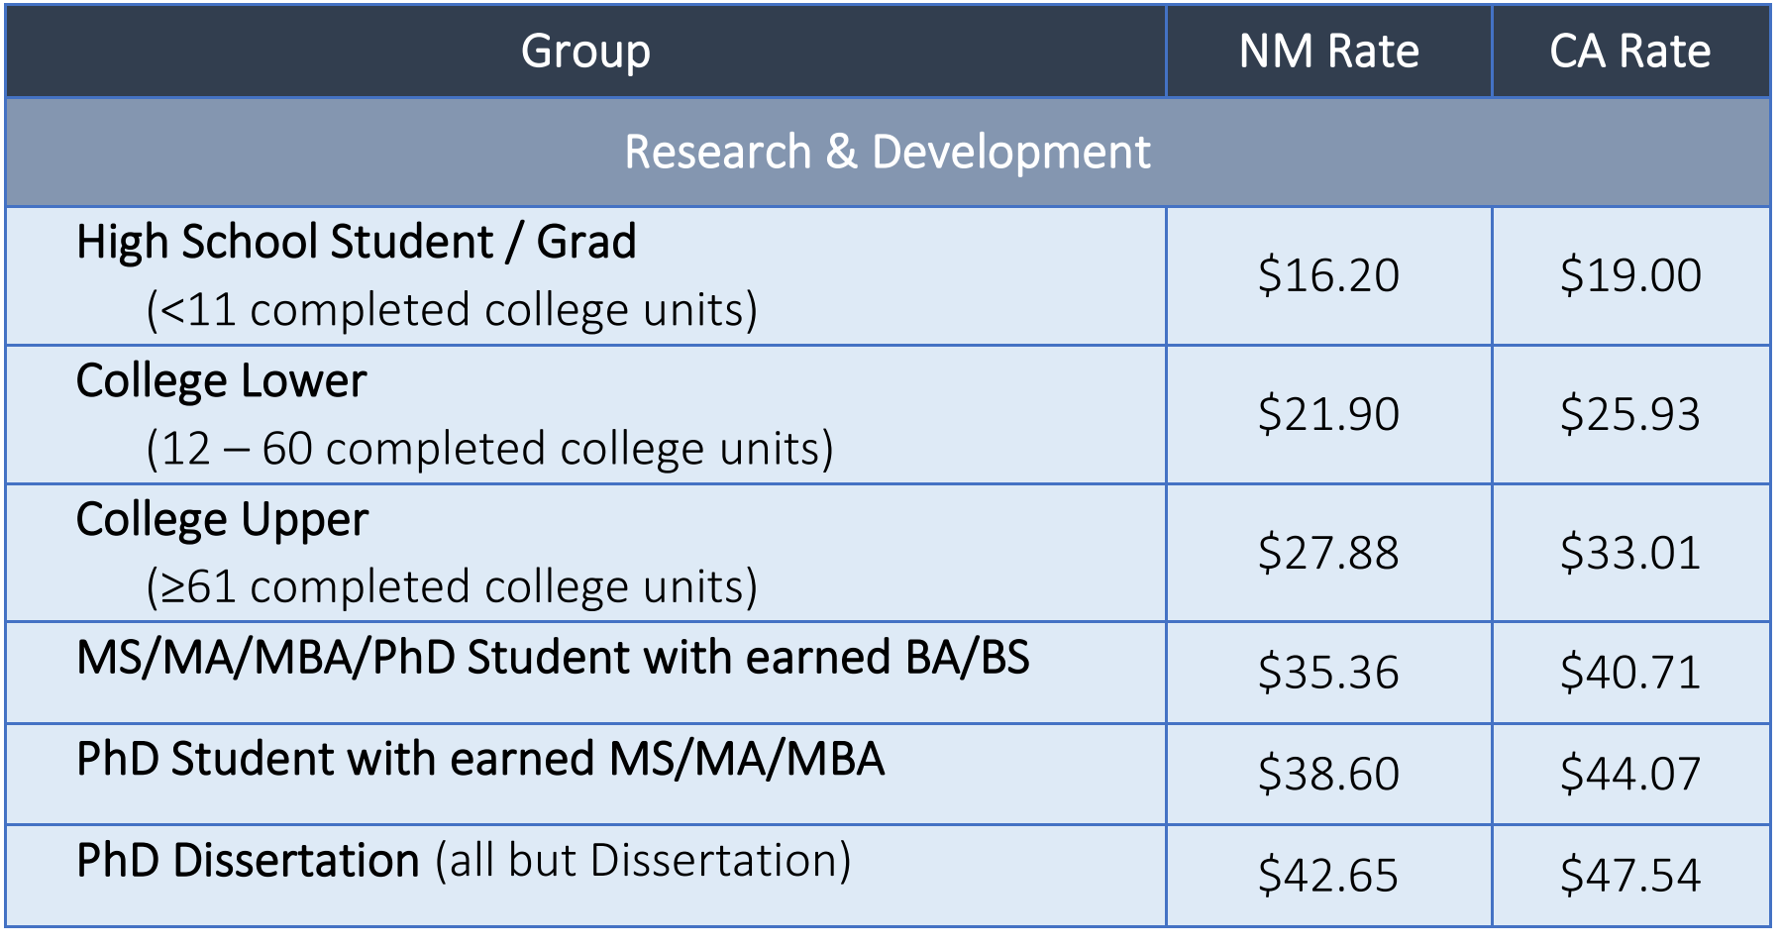
Application Process
Applied online
  Nonlinear Mechanics and Dynamics Research Institute (NOMAD)
One interview with the director of NOMAD
  Talked a lot about my research project and how “nonlinear” it is
A lot of paperwork

Slide 9
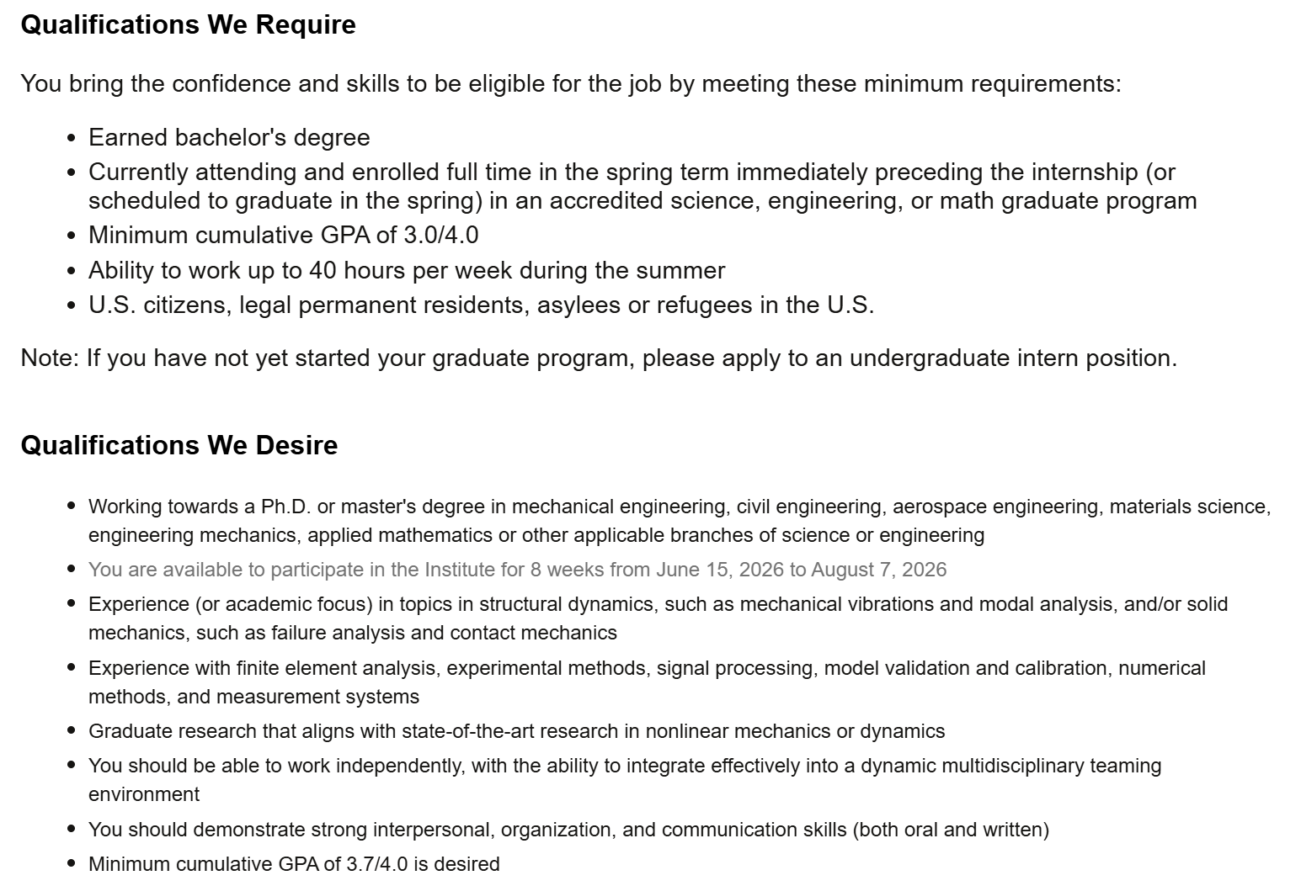
Qualifications Information

Slide 10
Fun Internship Pictures

Slide 11
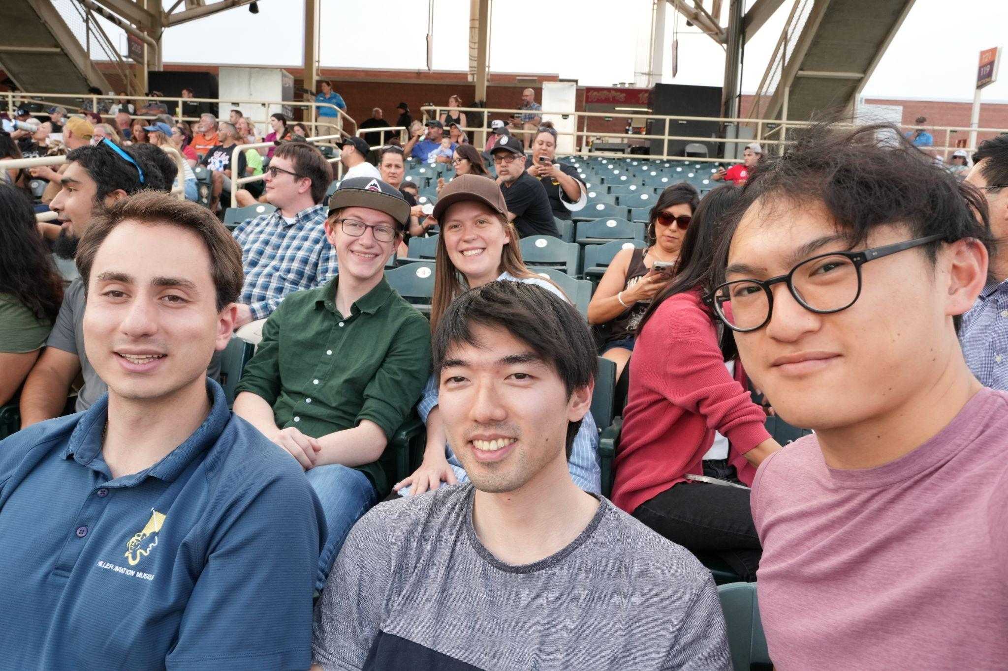
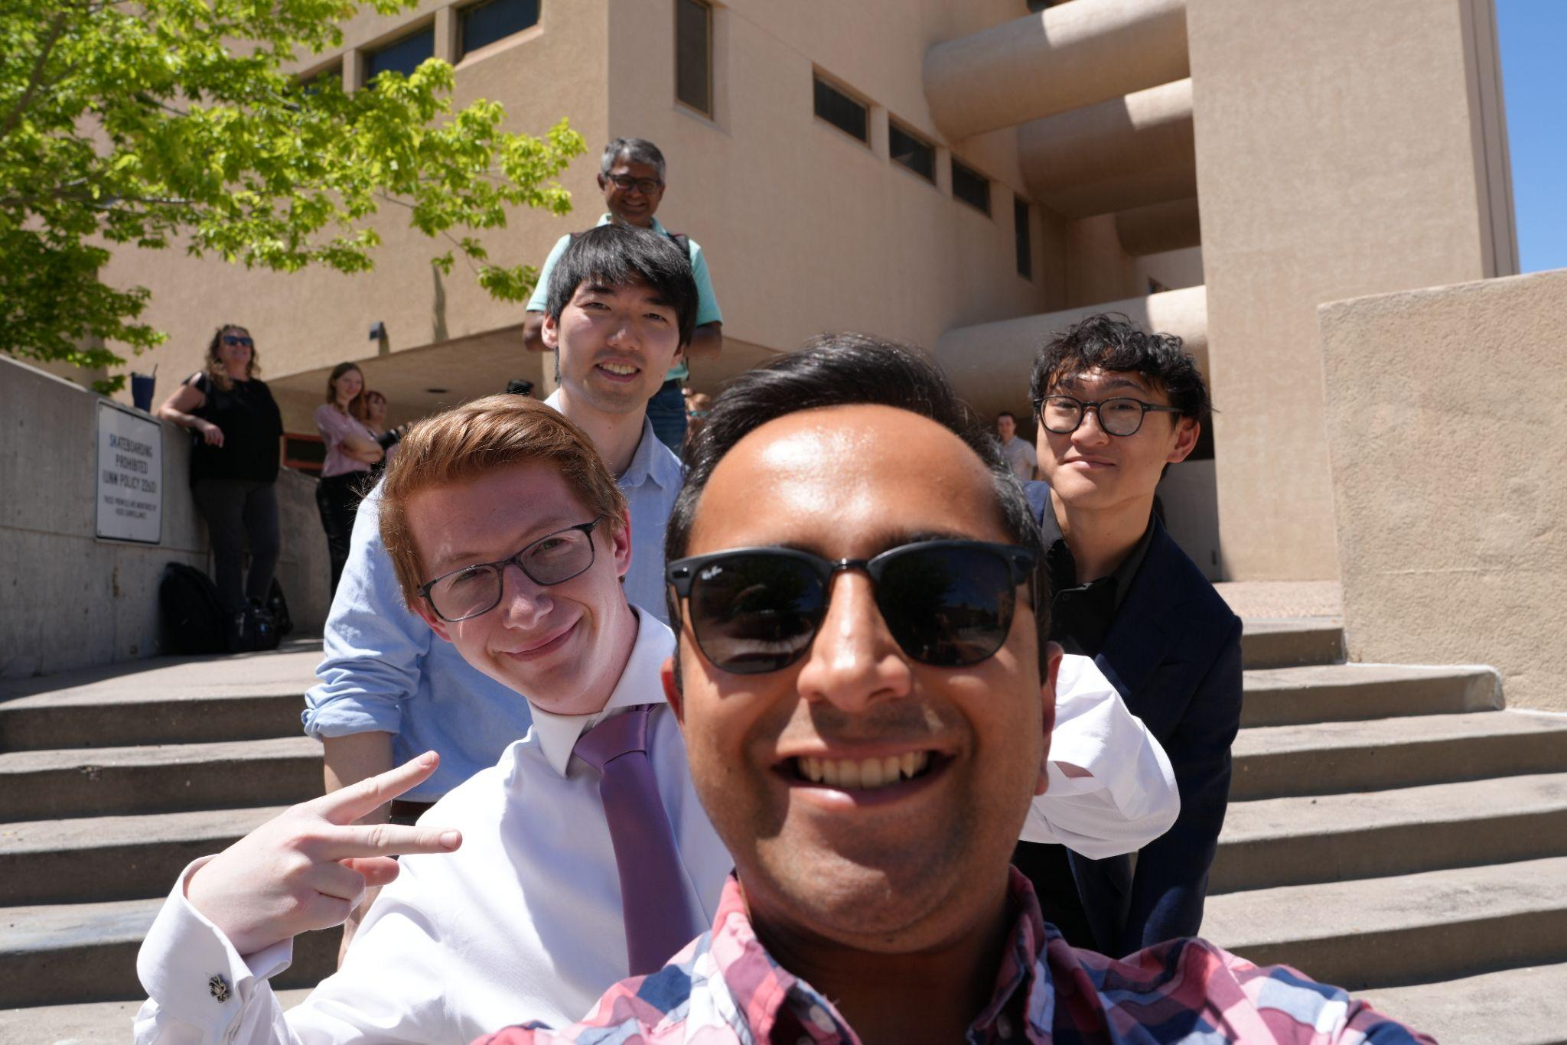
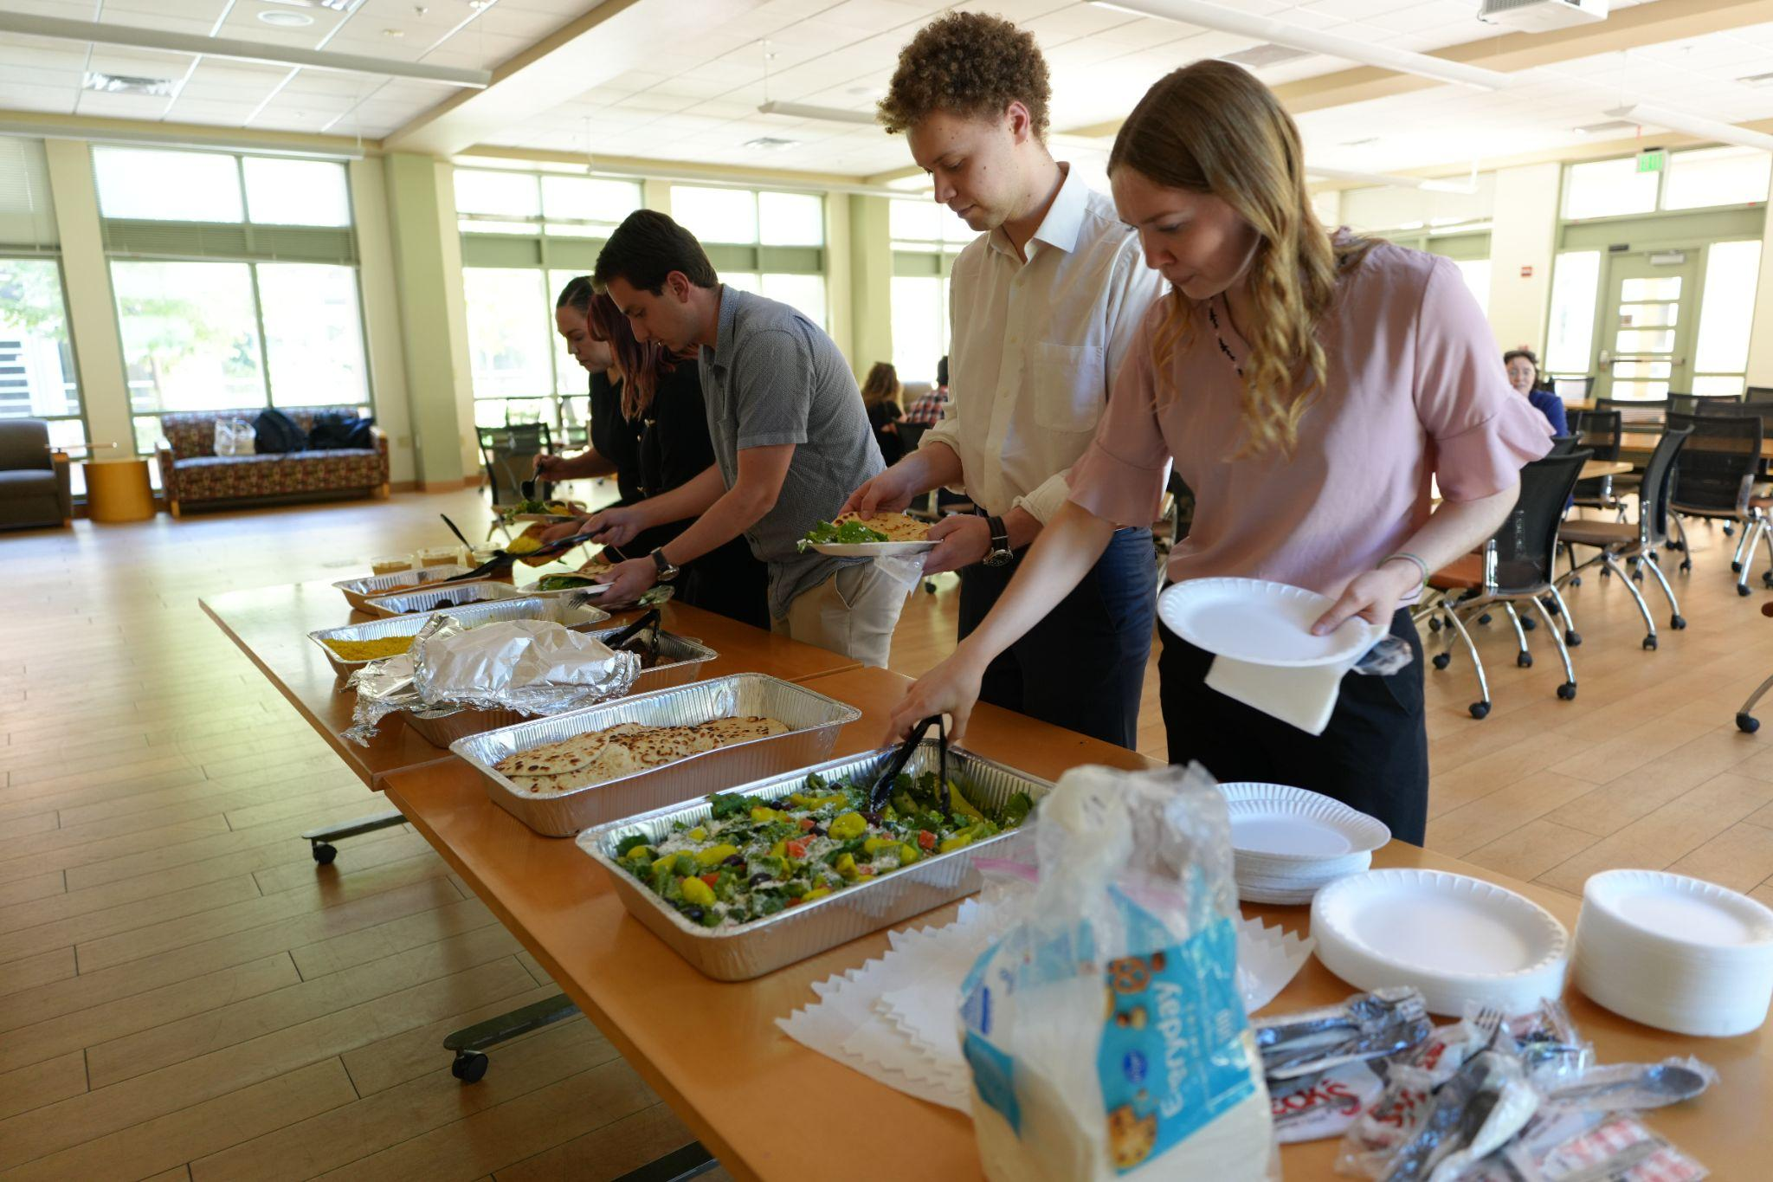
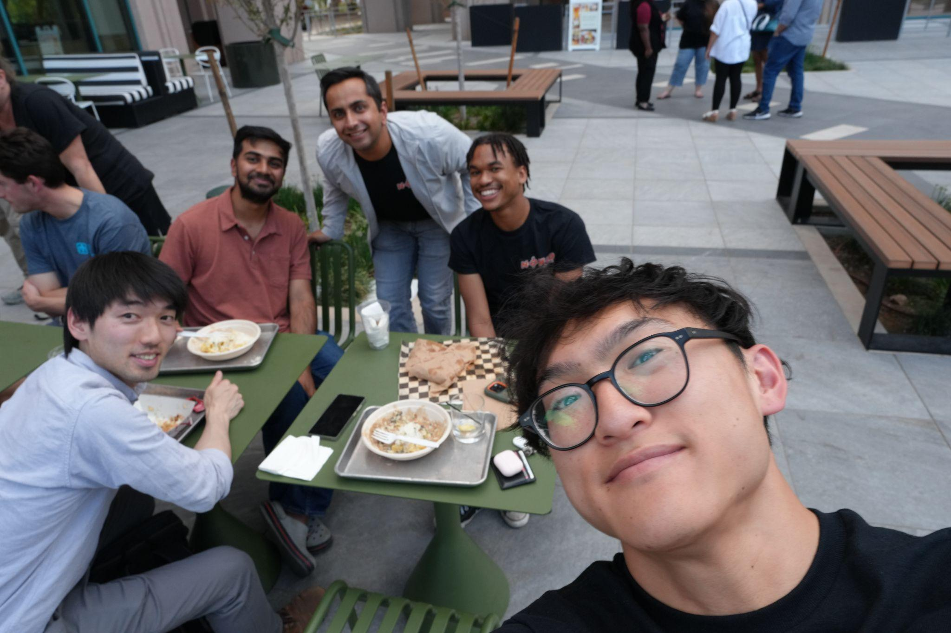
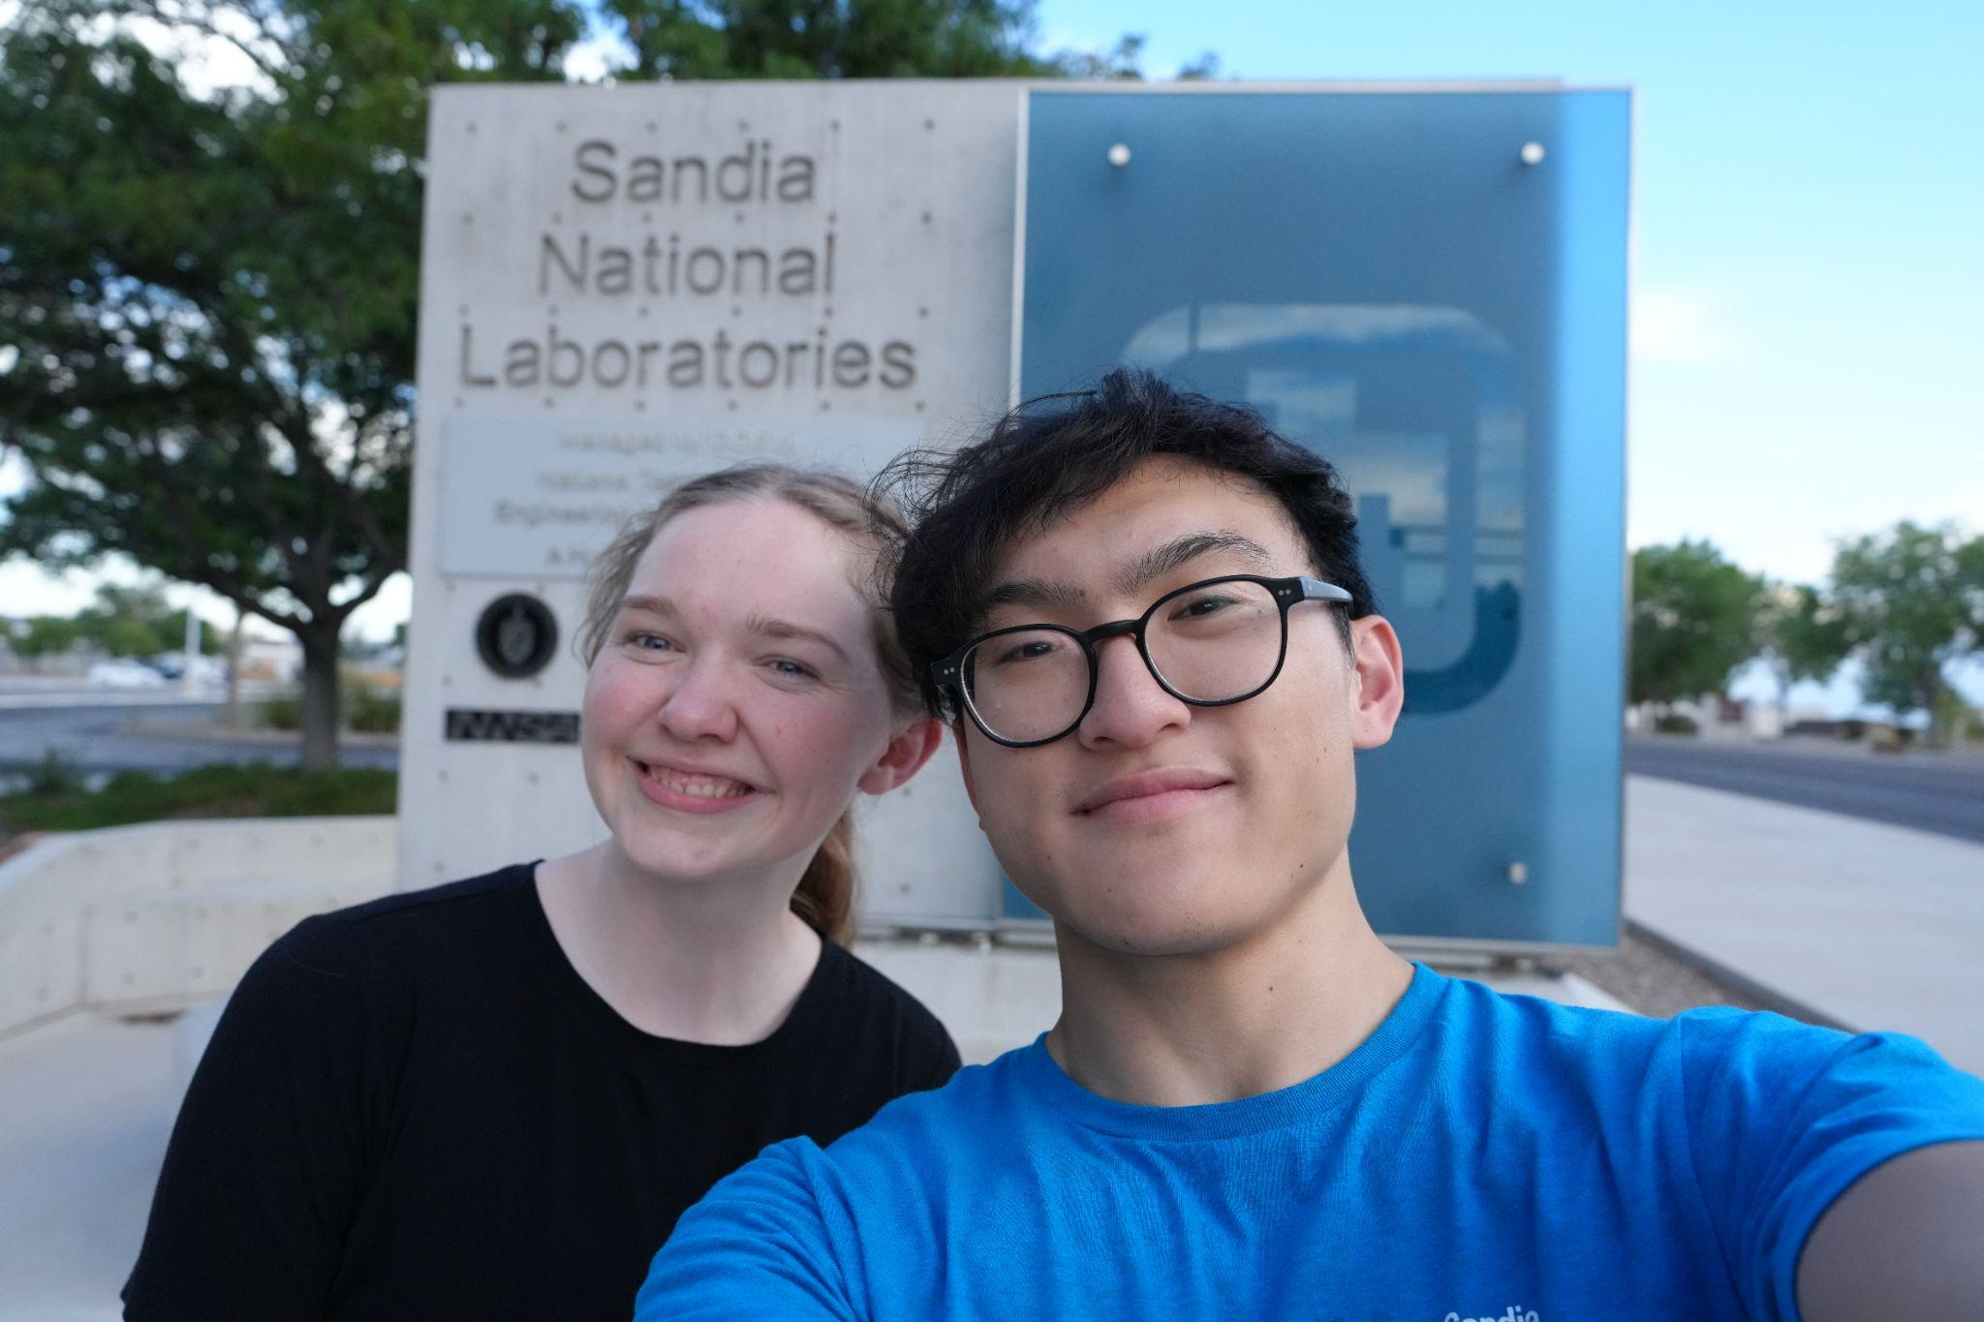
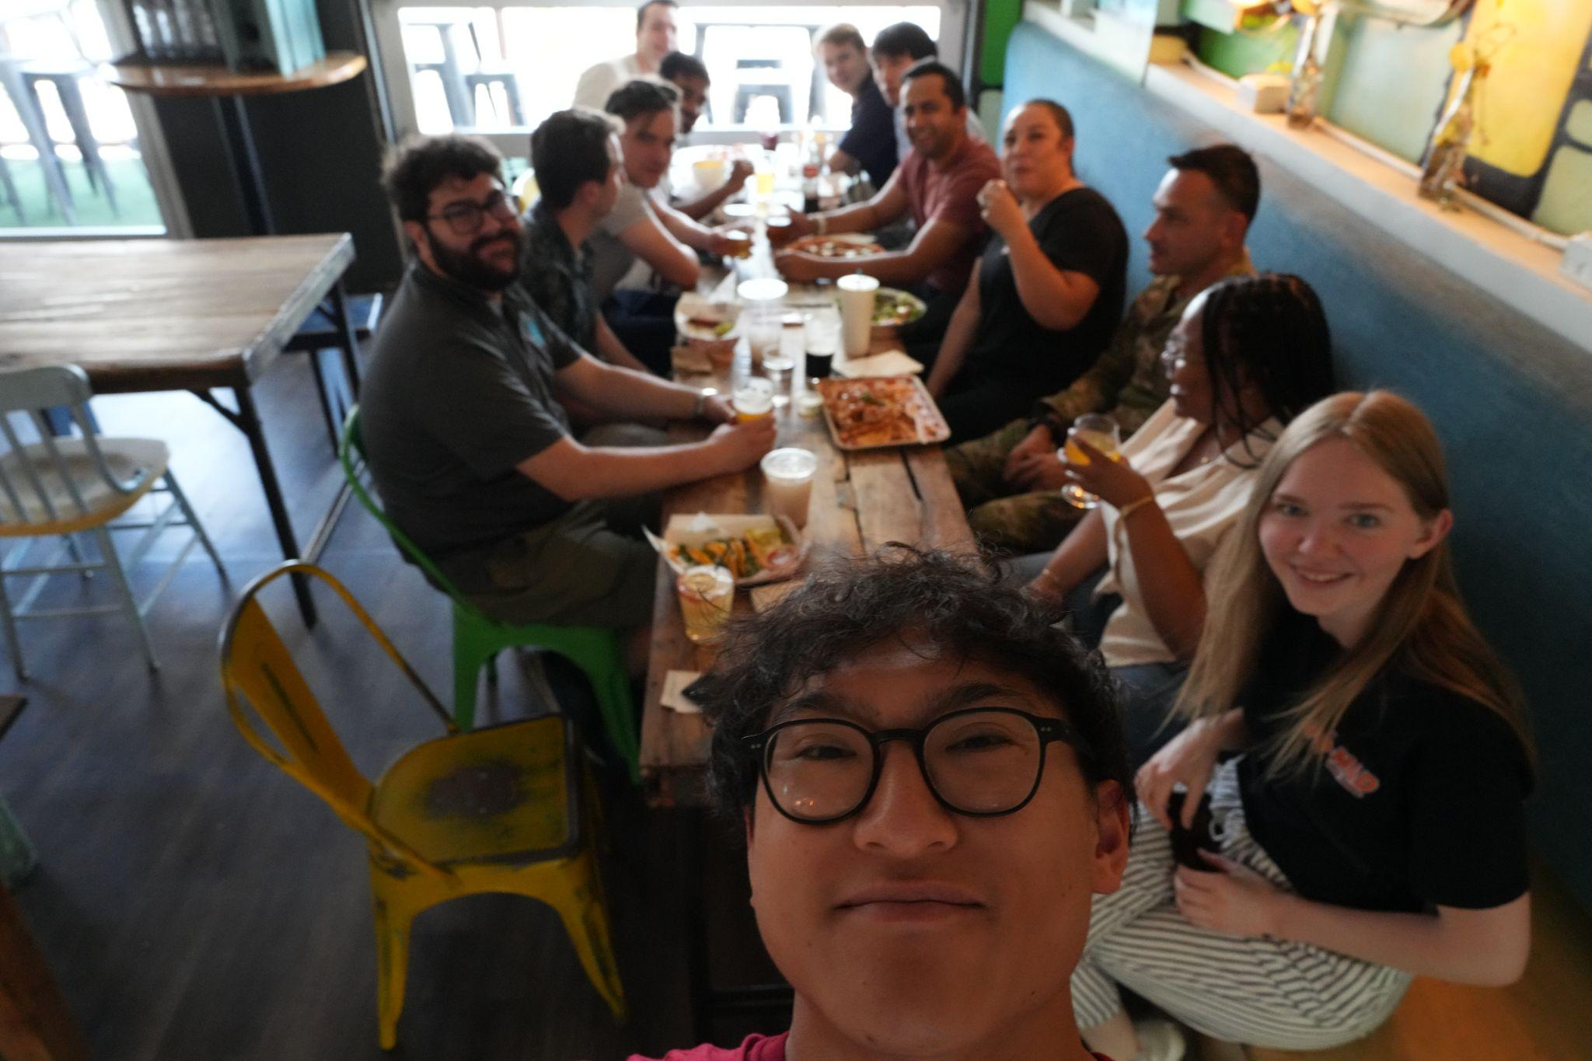

Slide 12
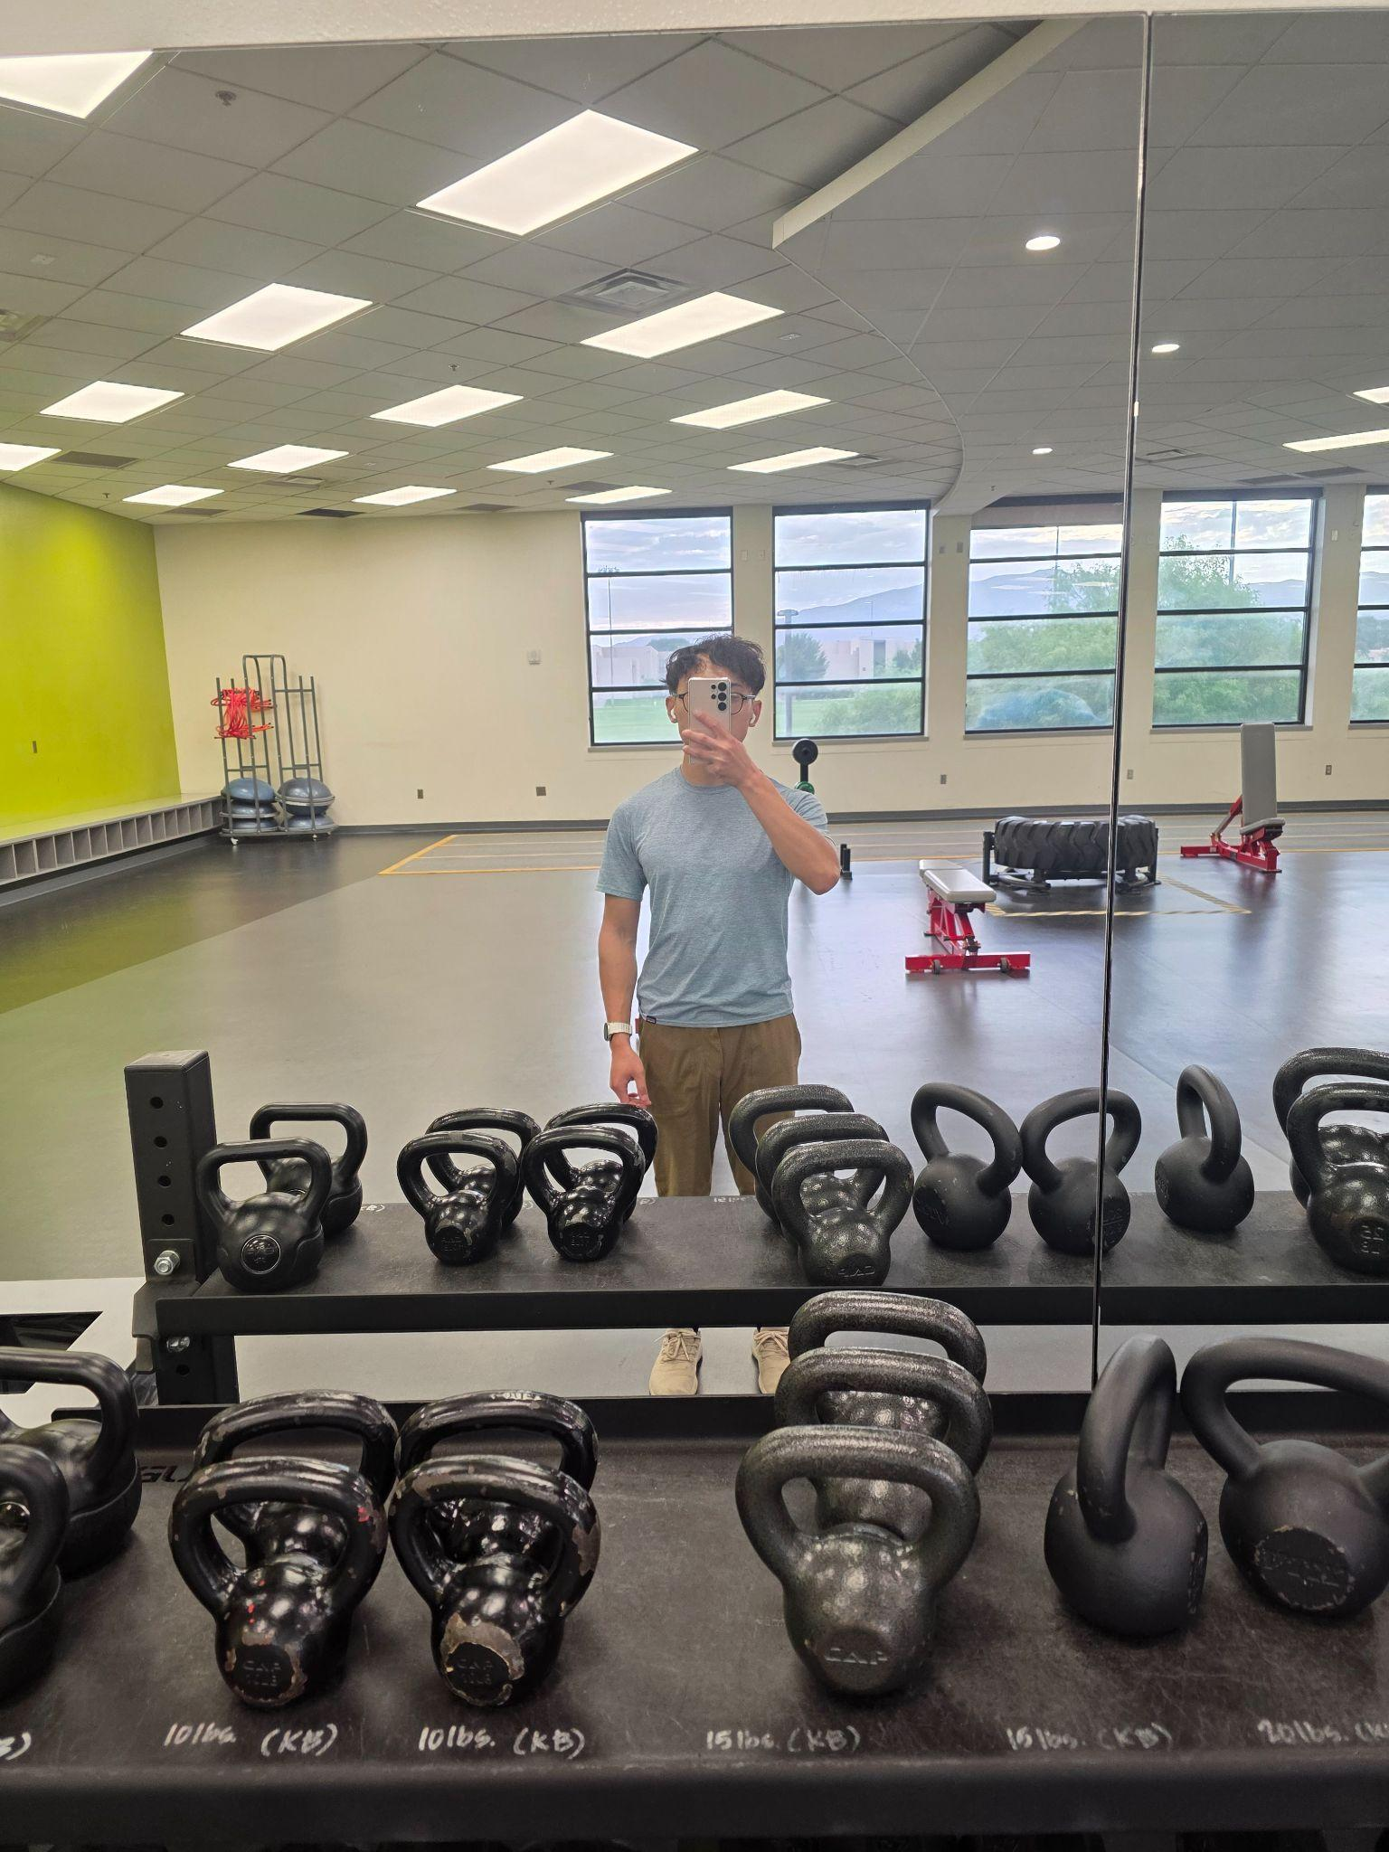
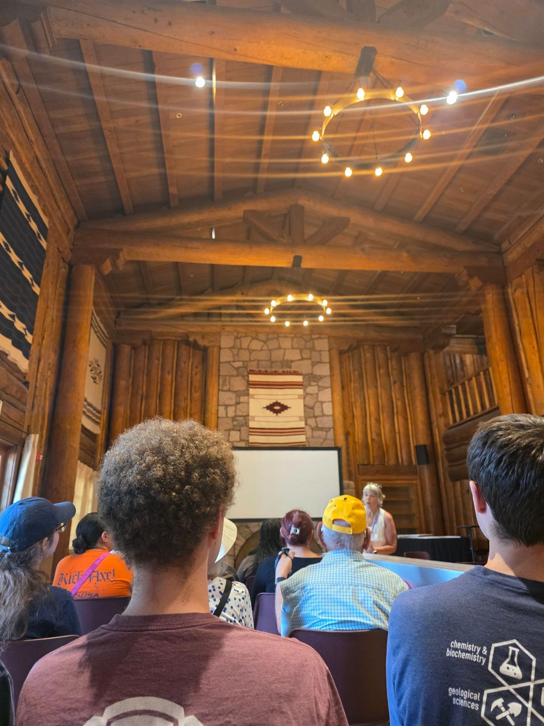
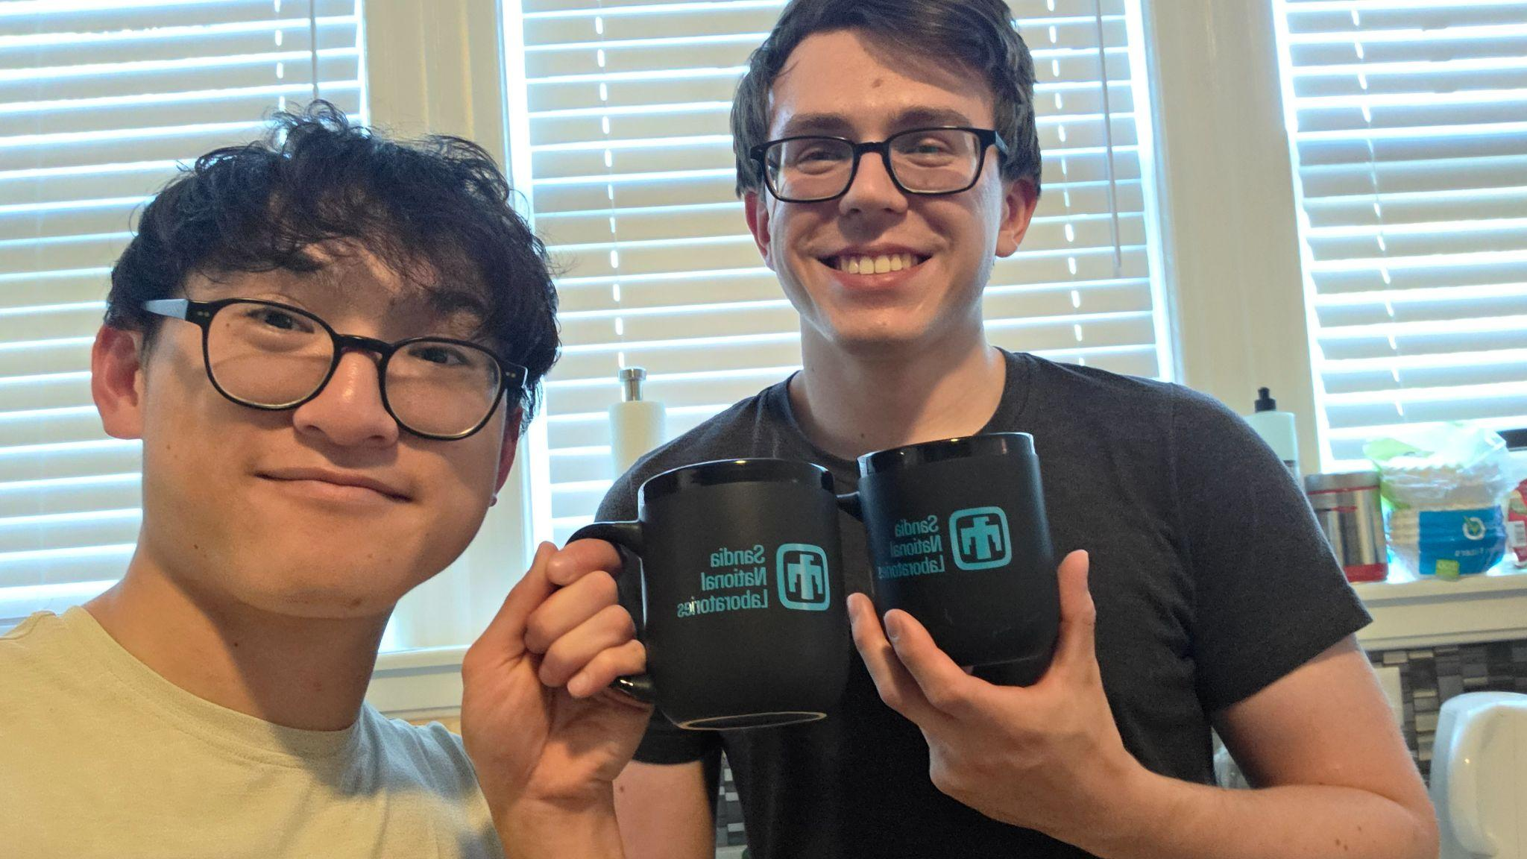
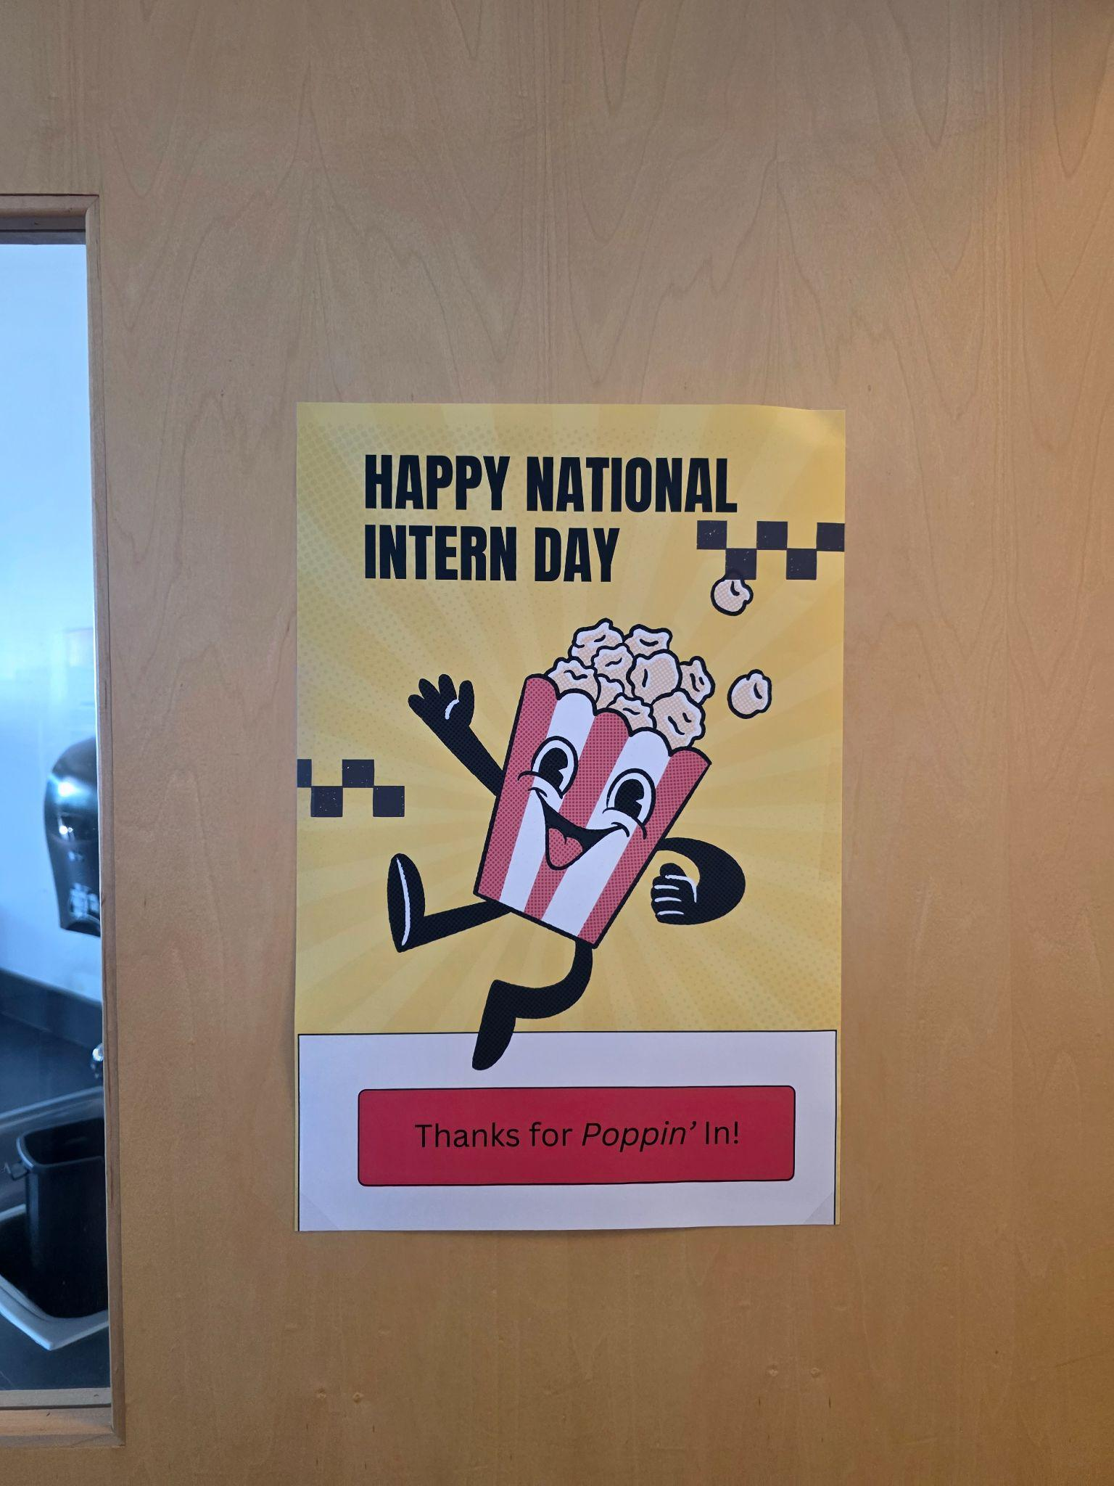
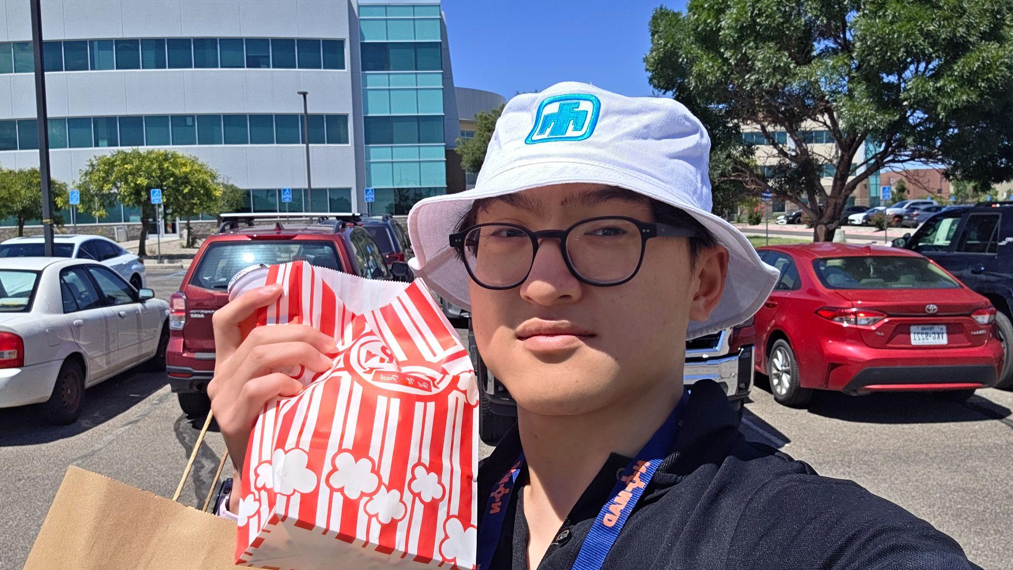
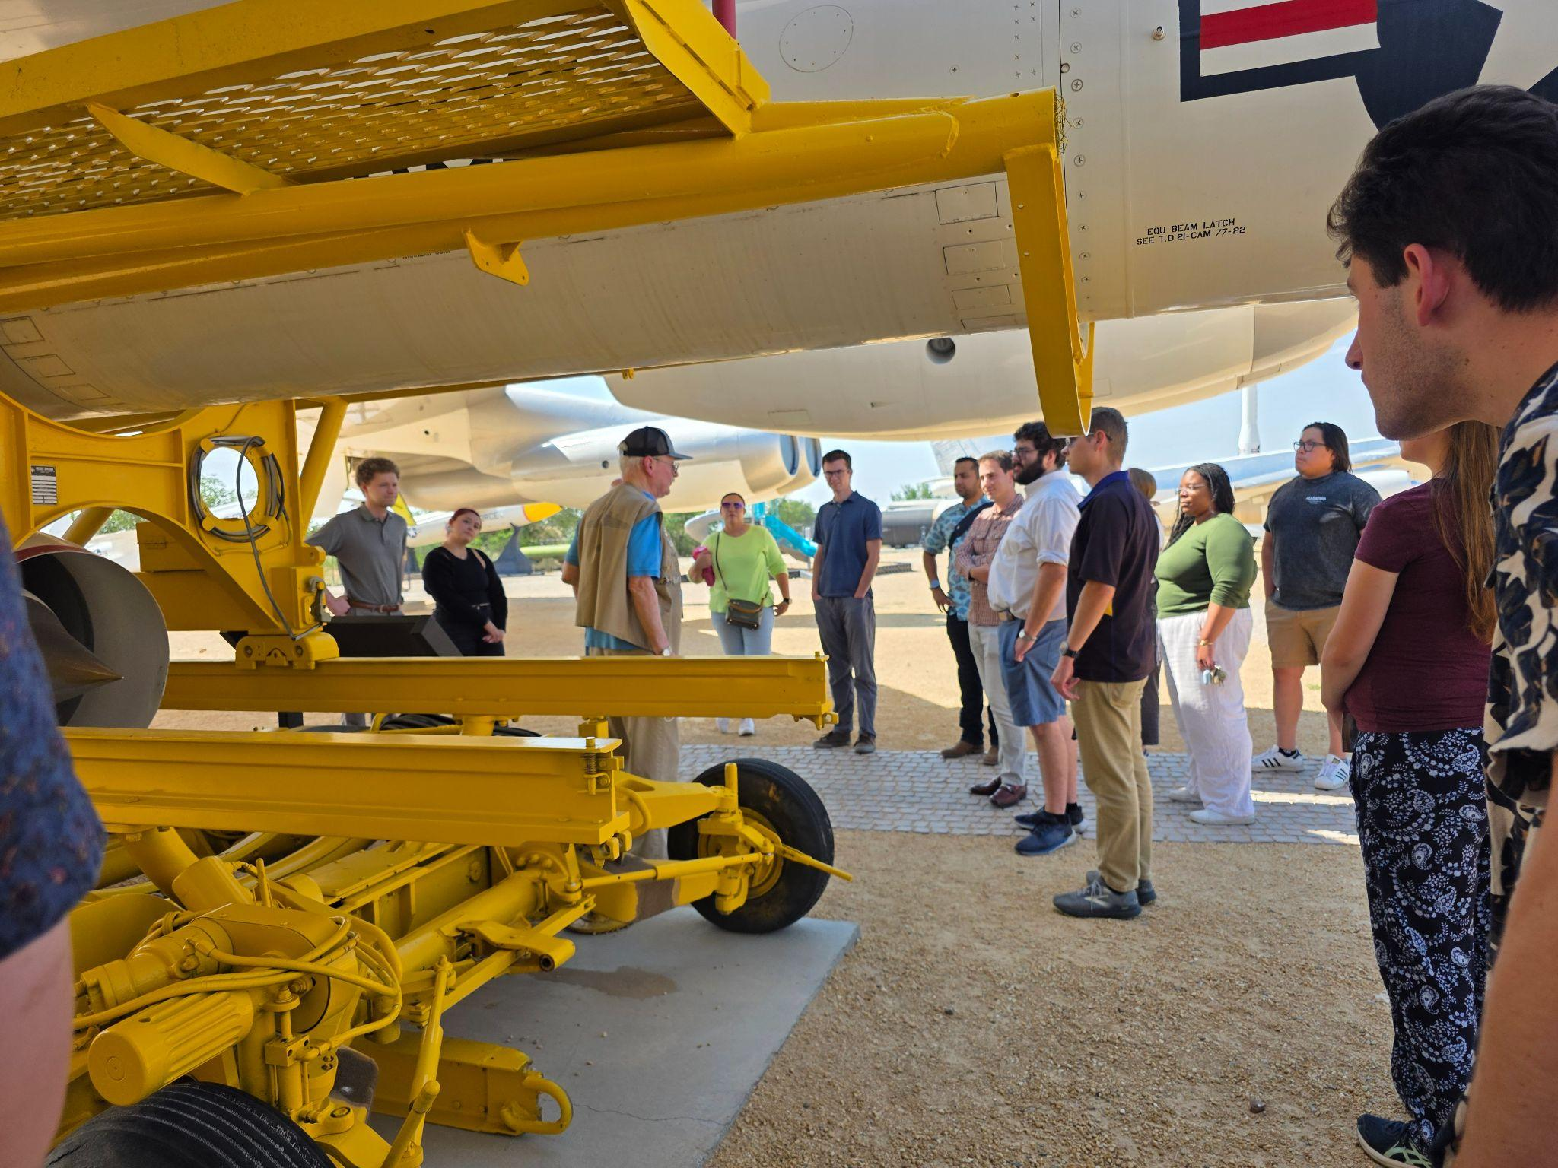
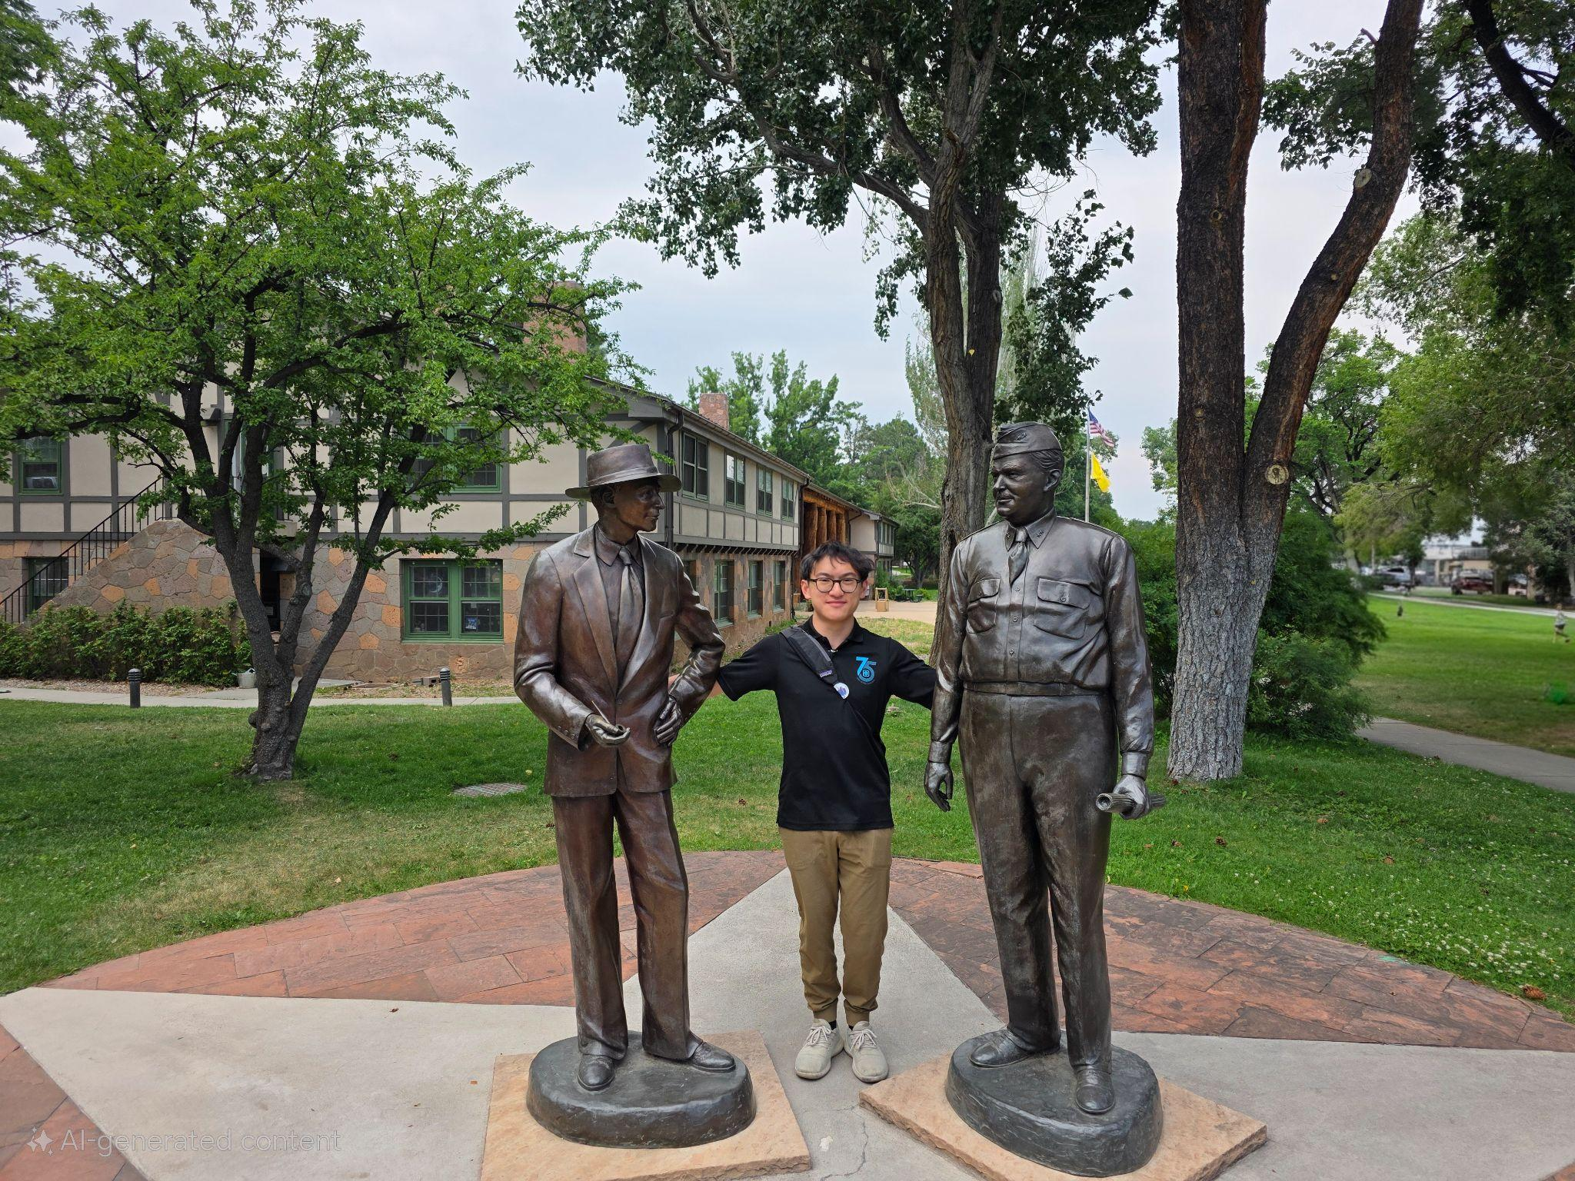
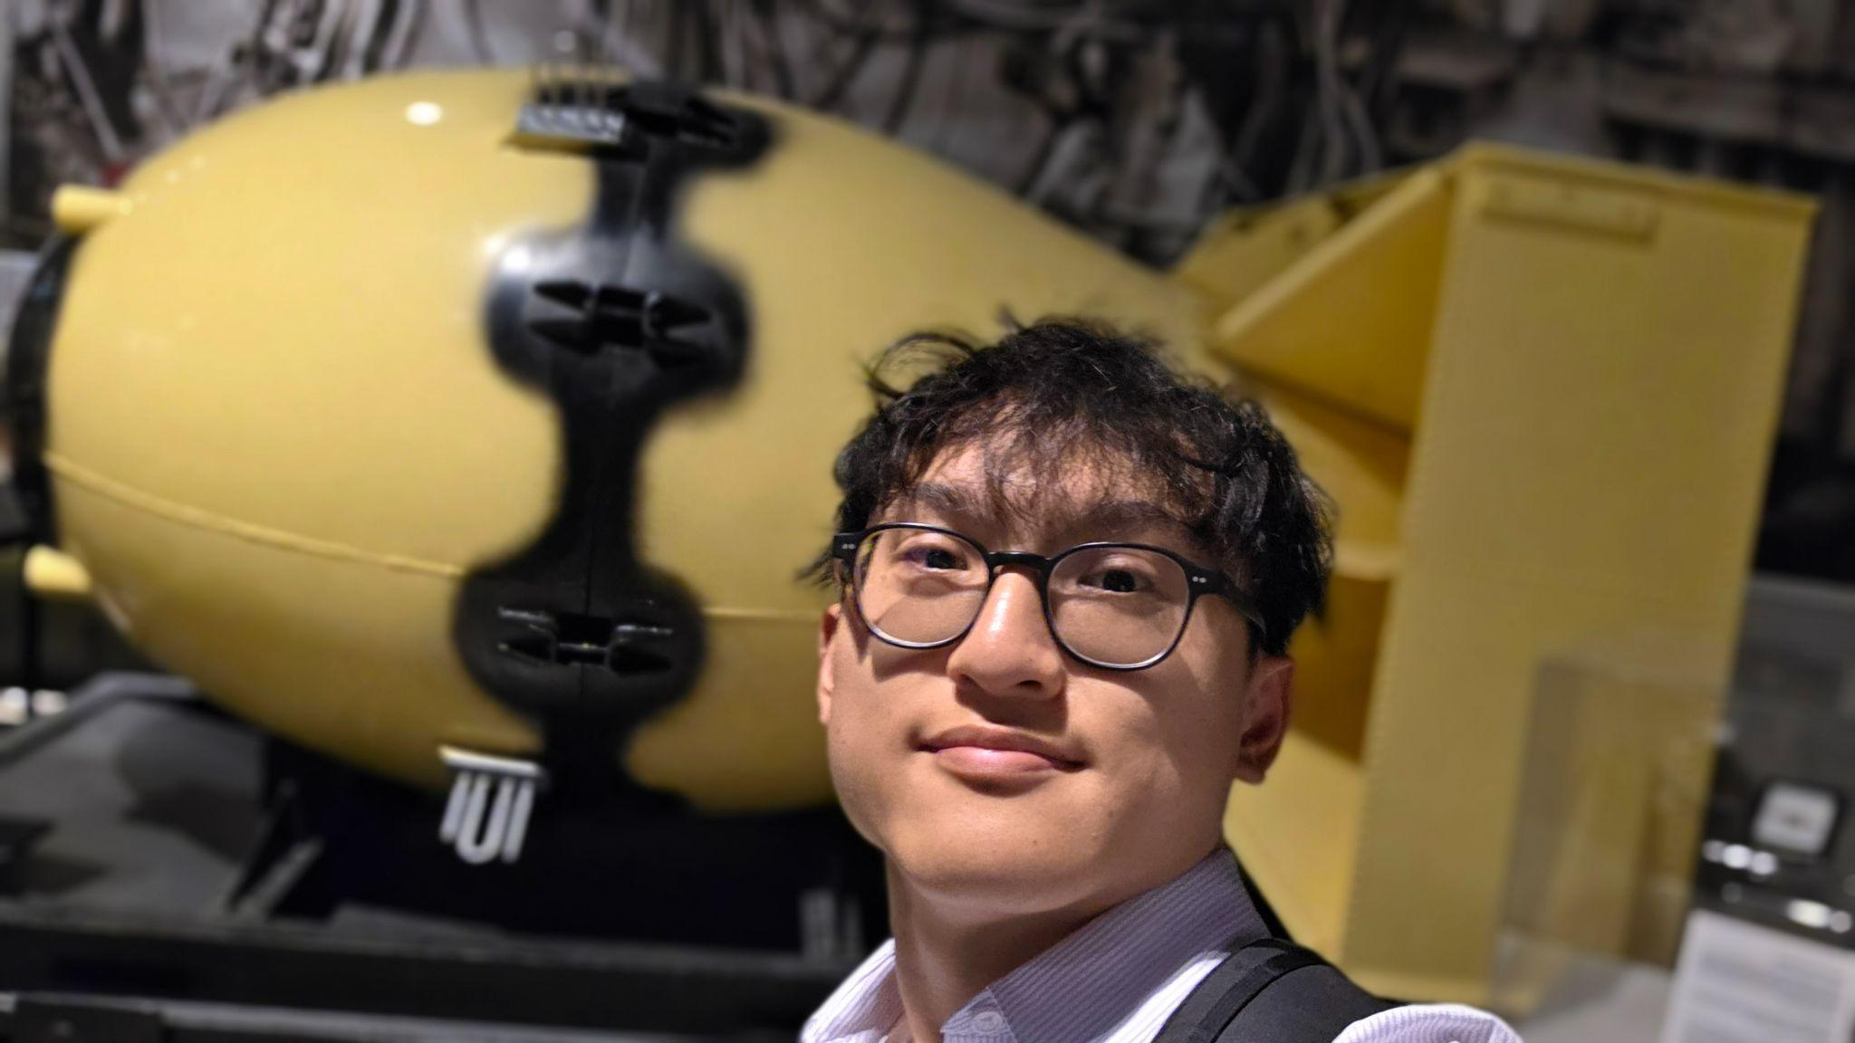

Slide 13
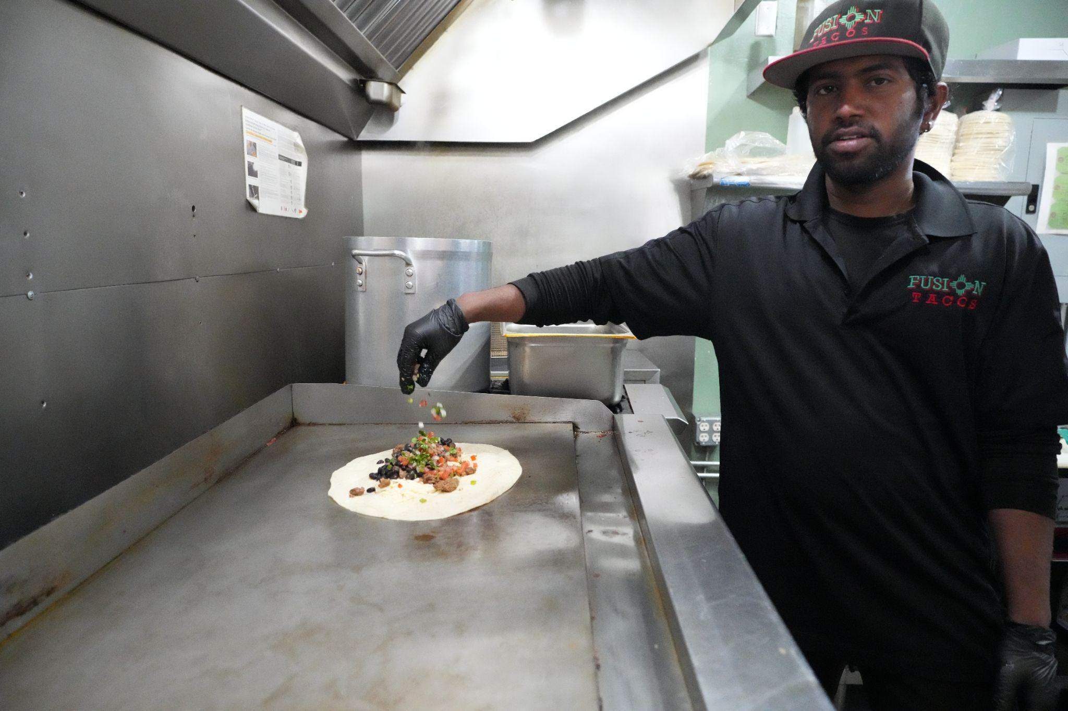
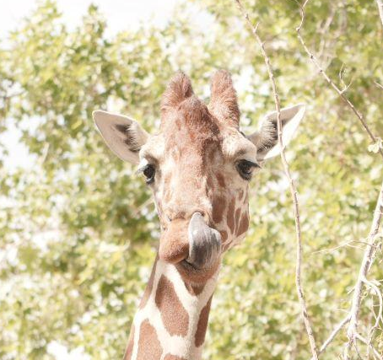
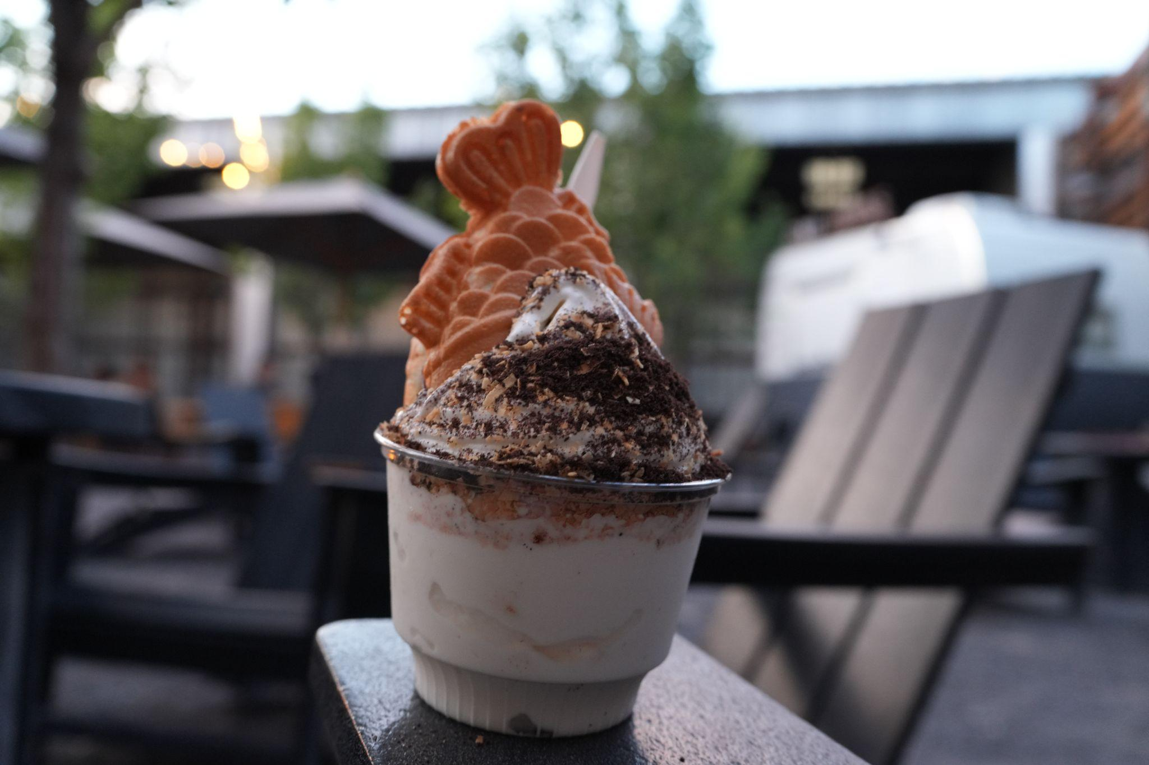

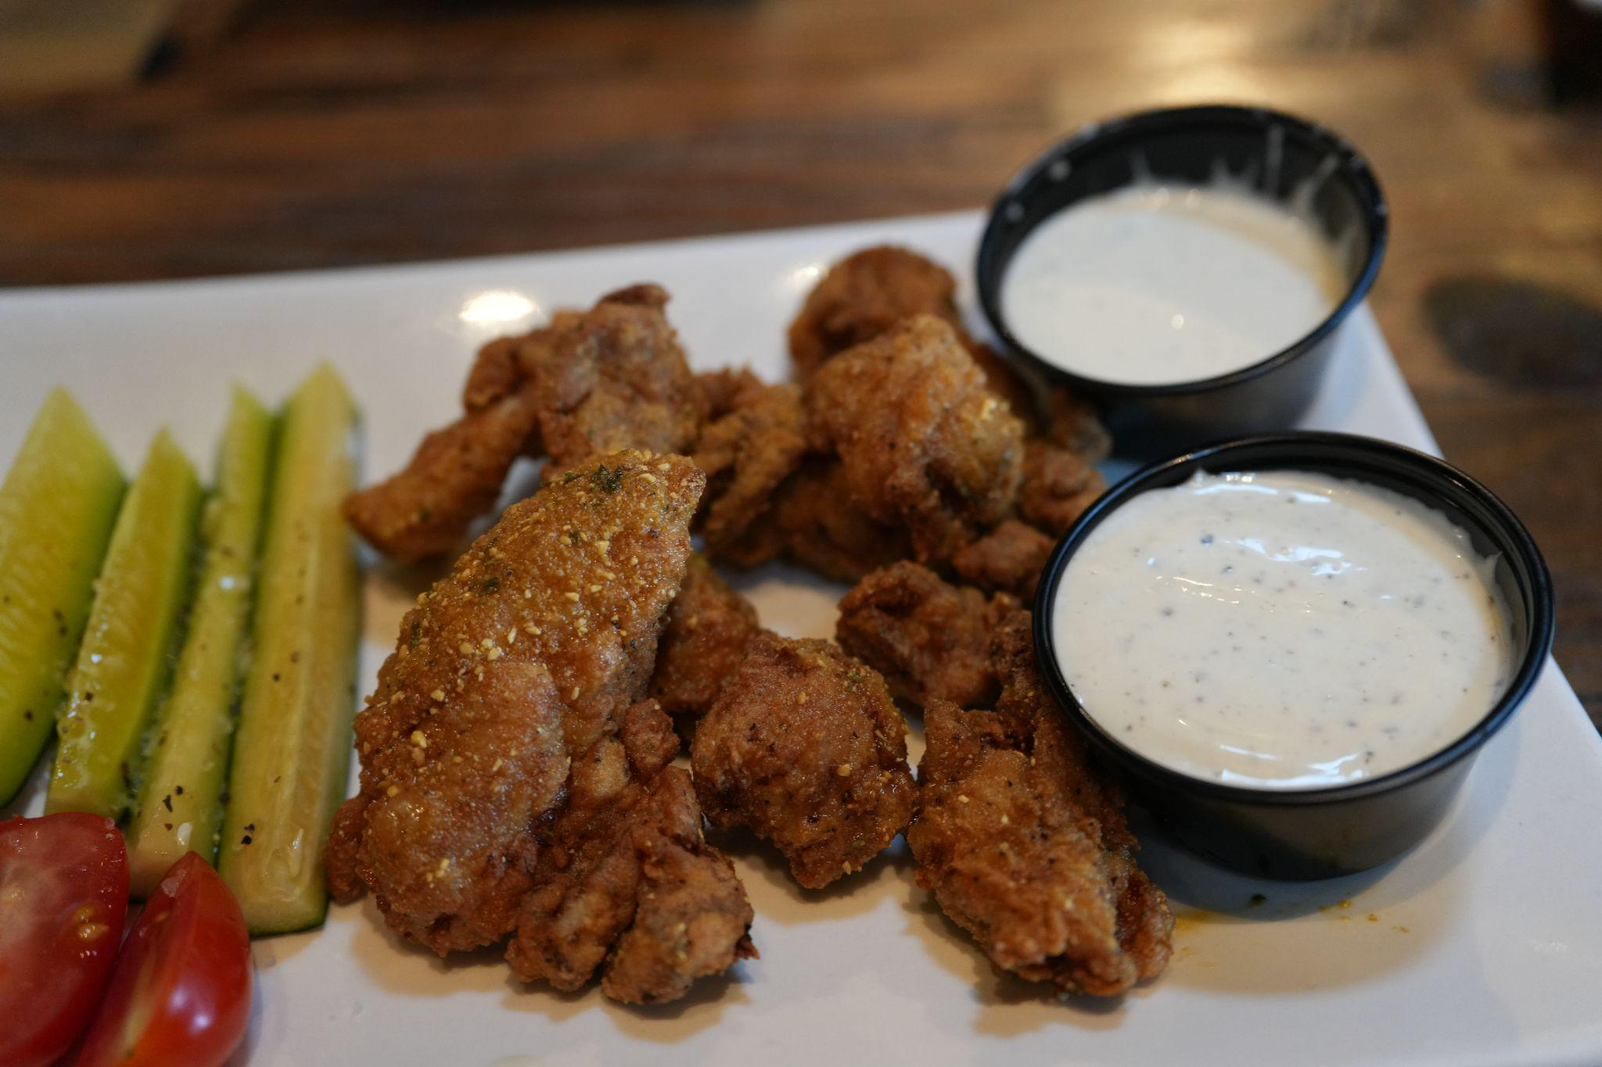

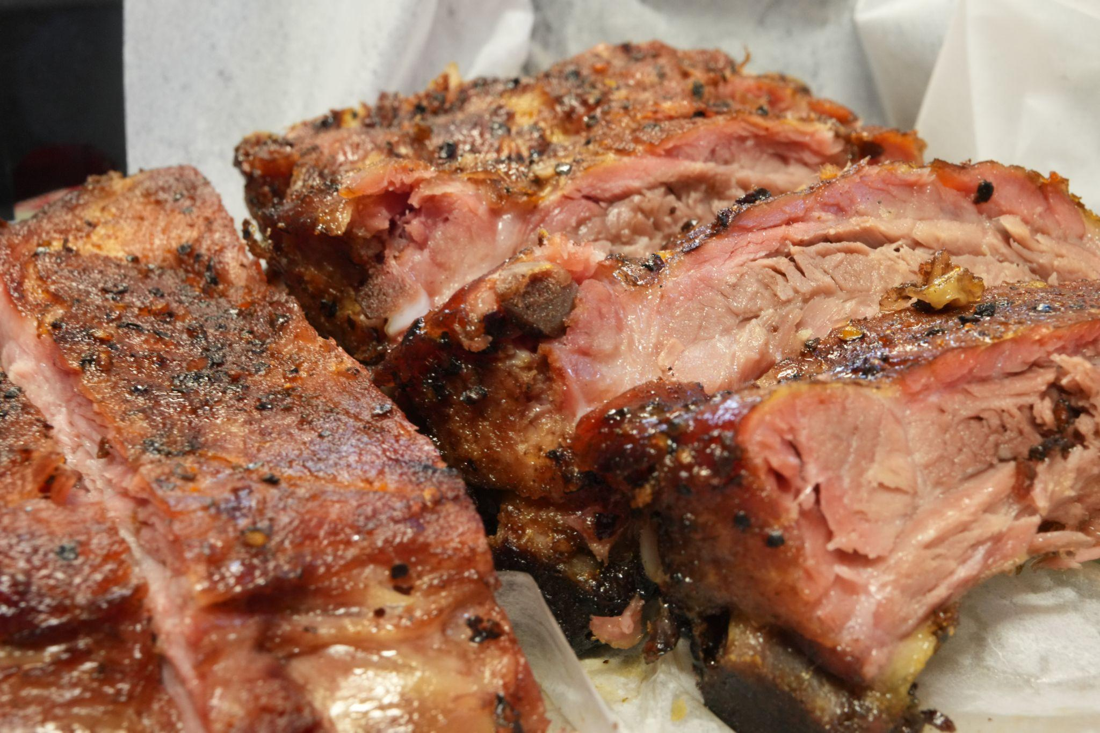
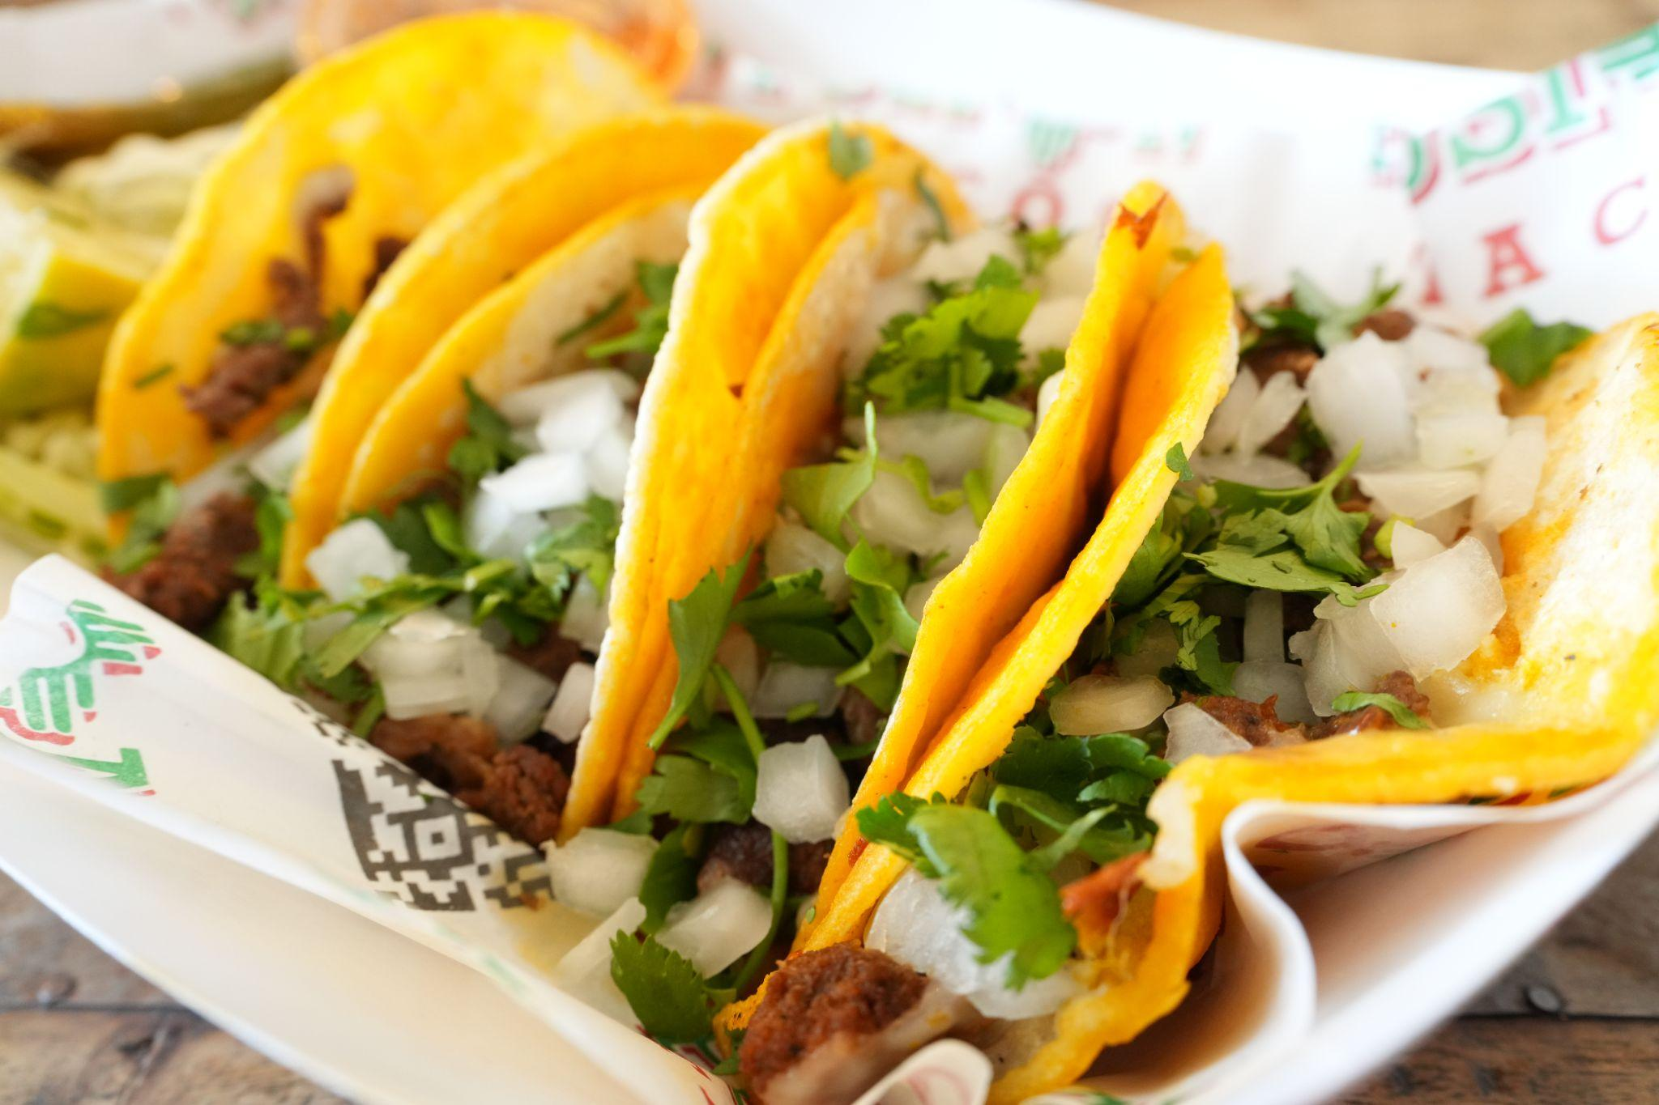

Slide 14
Research Projects

Slide 15
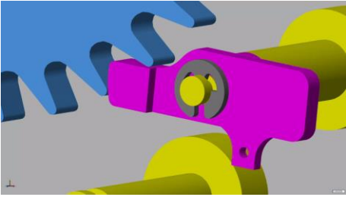
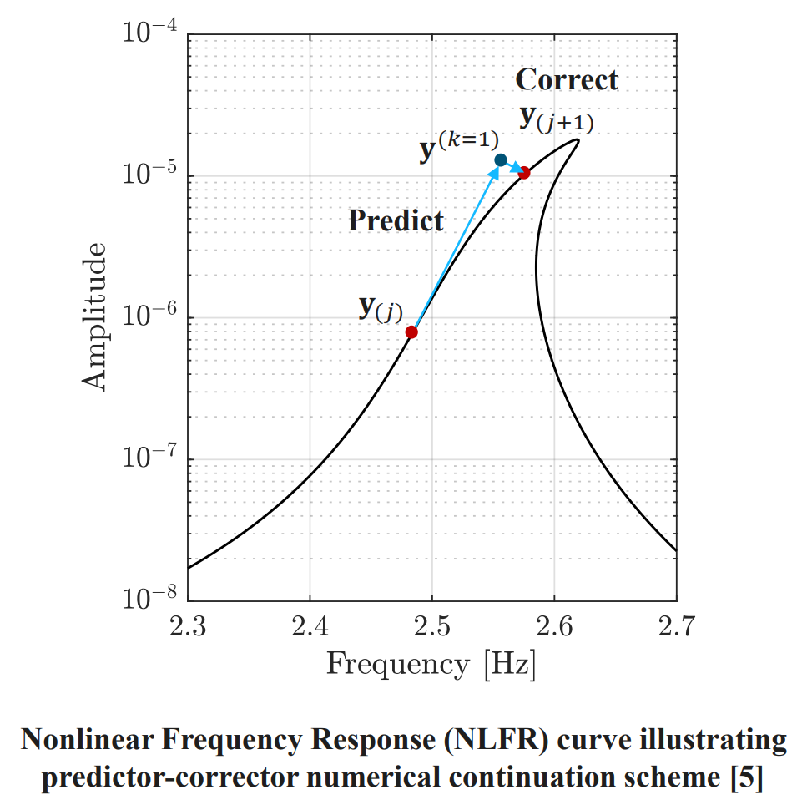
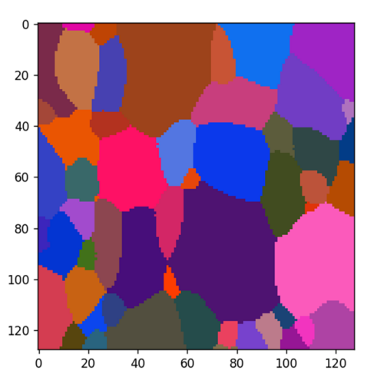
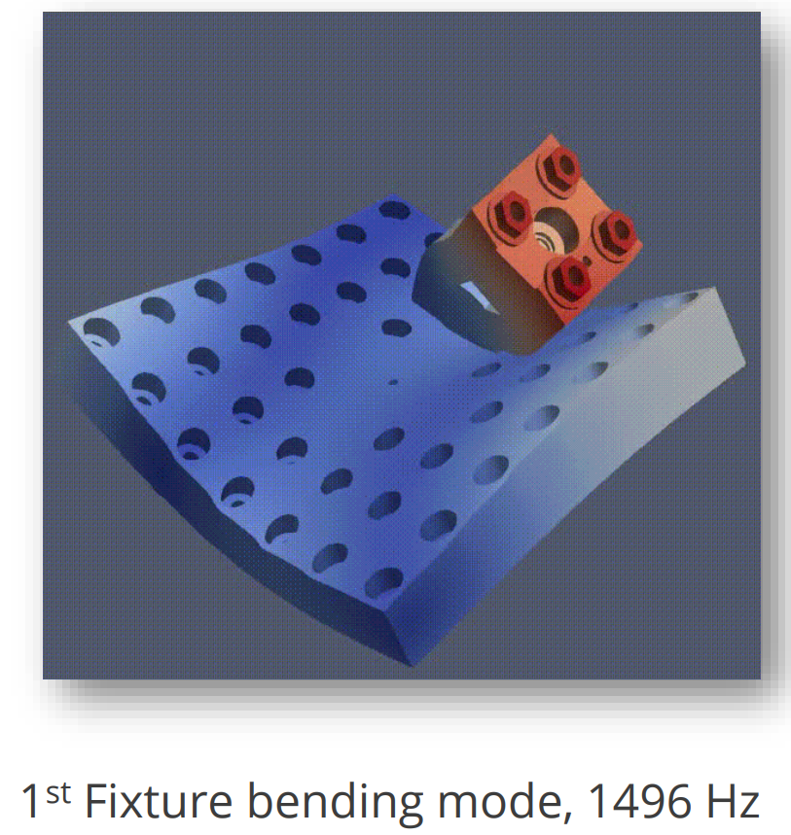
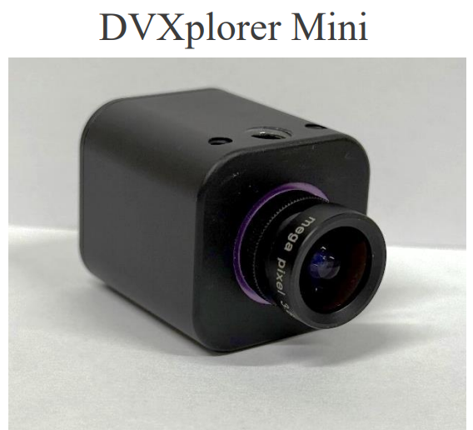
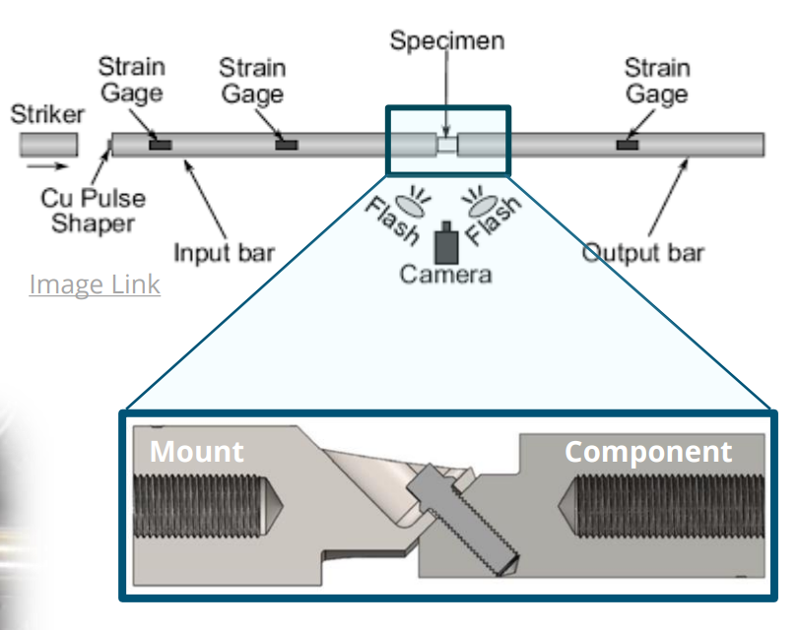
Research Projects
Projects (Simulation, modeling, experimental, FEA, material science)
  Electrical chatter and modal response of pin-receptacle contacts in oil
  Modal expansion of nonlinear vibration response using neuromorphing event-based imaging
  Verification and convergence of the method of harmonic balance within Sierra/SD FEA Code
  Bolted joint friction modeling under shock loading
  Investigating the microstructure and properties relationship of Ta-alloy
  Quantifying the effect of non-physical parameters on the nonlinear dynamics of an electromechanical ratcheting mechanism

